Slide 1
Deploy with AVI
Version 2

Slide 2
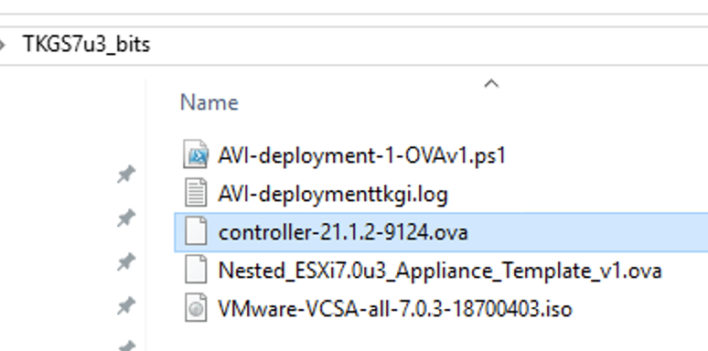
Versions used

Slide 3
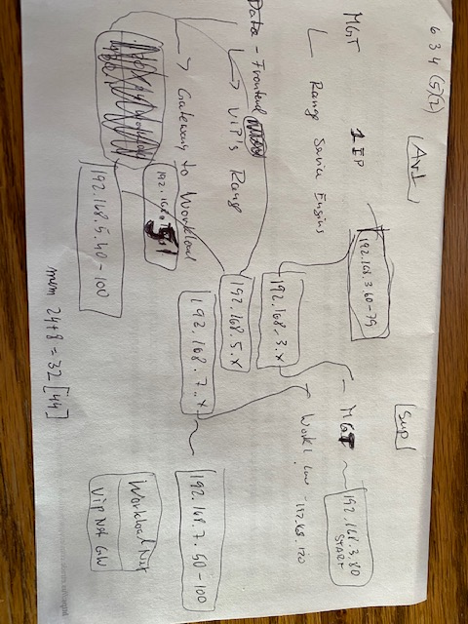
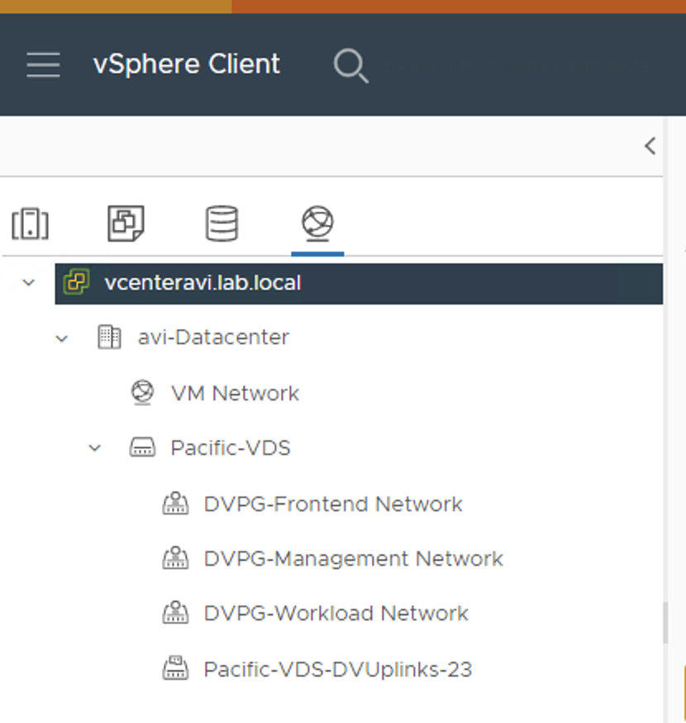
Set up

Slide 4
My Network layout (.3)(.5)(.7)
AVI Supervisor
192.168.3.40 (AVI) 192.168.3.x MGT .50 vCenter .51-3 ESXi
192.168.3.60-79 MGT 192.168.3.80 (Start)
192.168.5.x Front
192.168.5.40-100 Front
192.168.7.x Workload
Route 192.168.5.1 (192.168.7.0/24) Workload 192.168.7.50-100

Slide 5
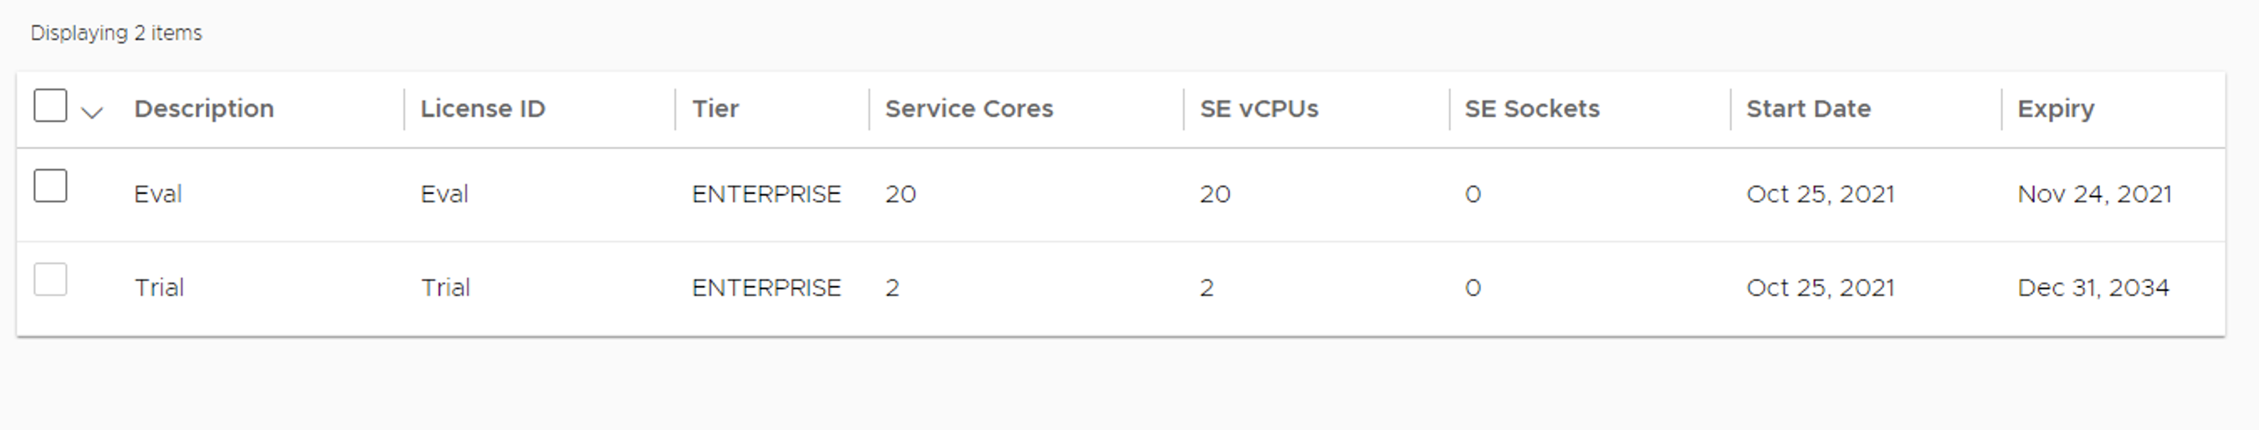
Default AVI license after install

Slide 6
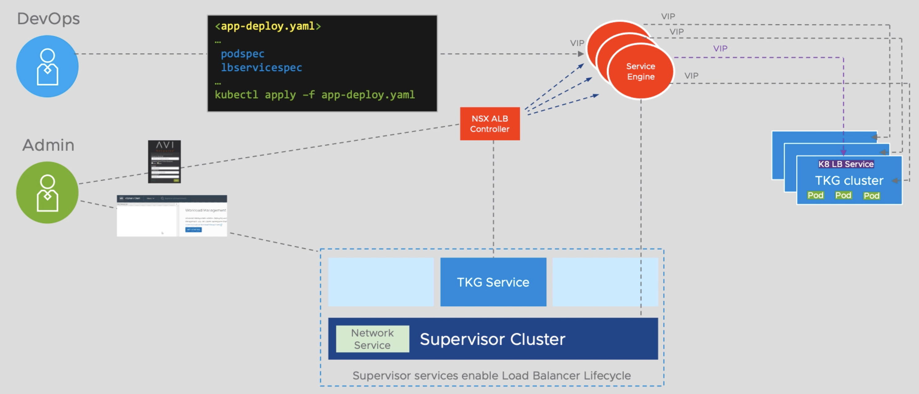
AVI Layout

Slide 7
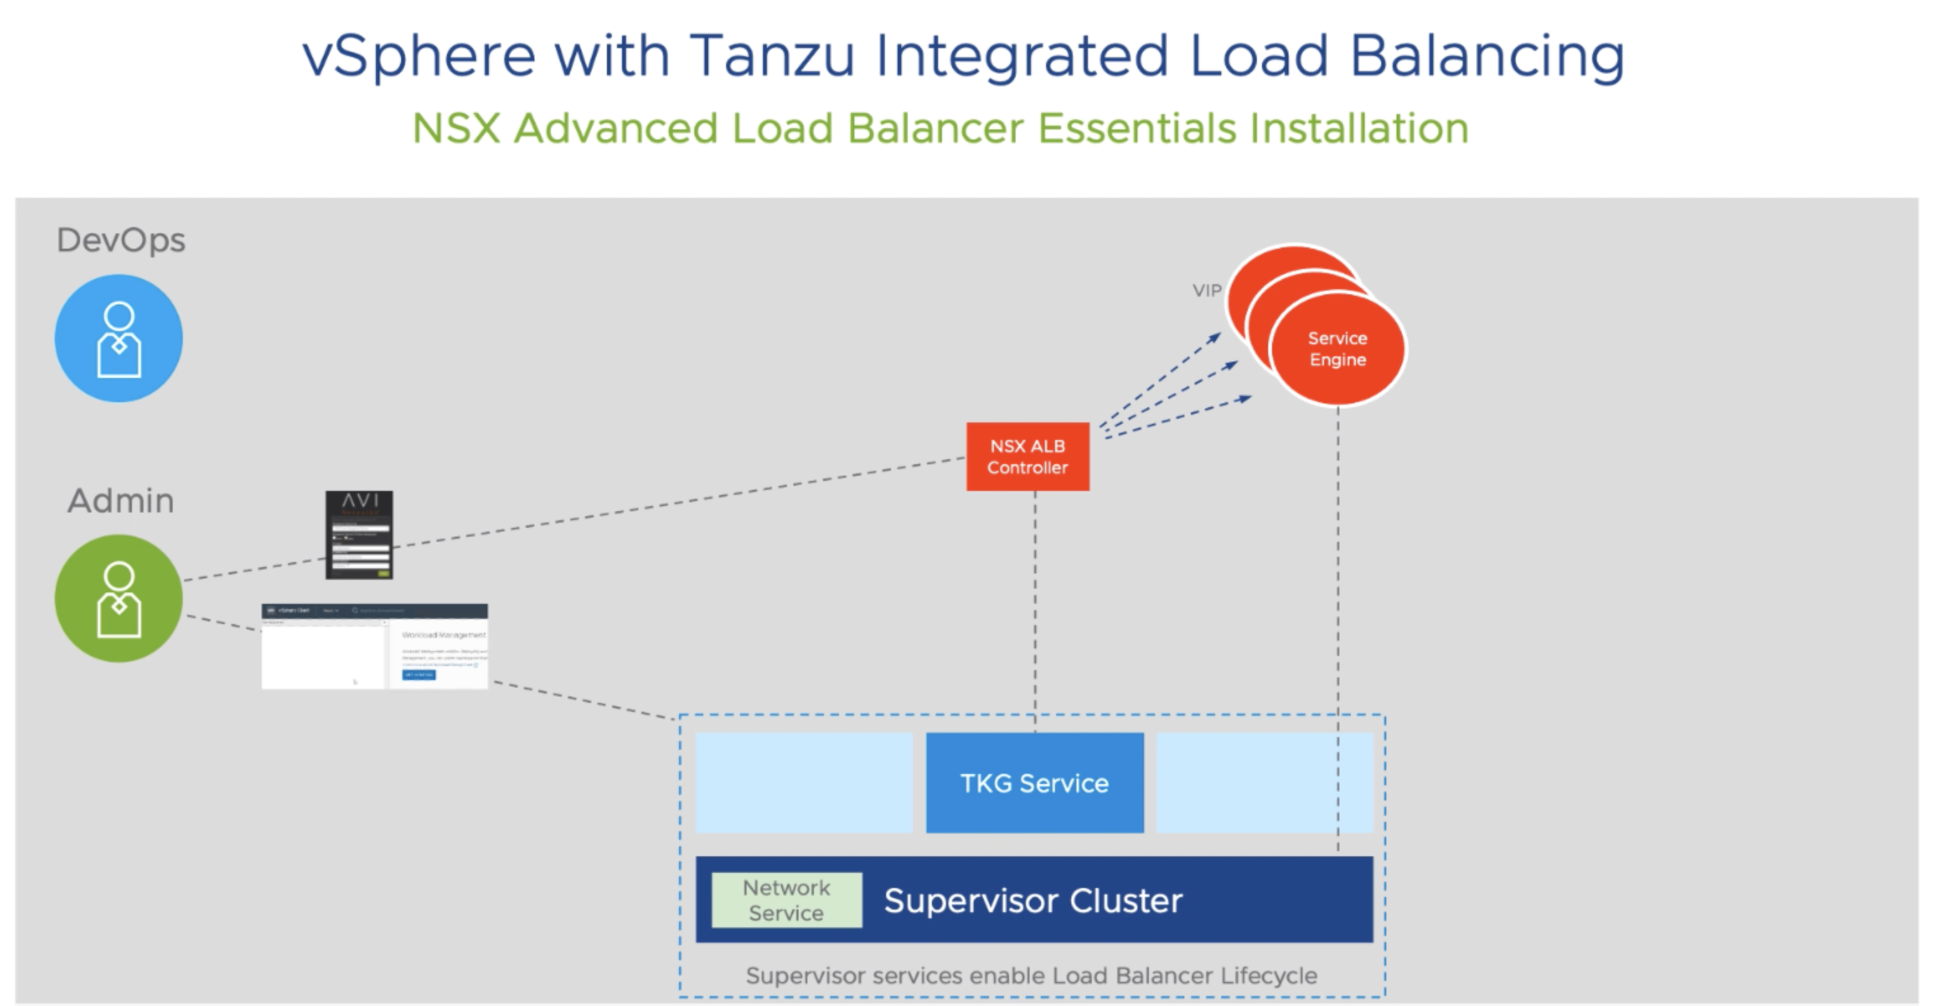
AVI Layout

Slide 8
Deploy
Deploy Avi Controller OVA
Deploy vCenter OVA
Deploy ESXi hosts (vSAN)
In my case all automated via William Lam’s Powershell scripts

Slide 9
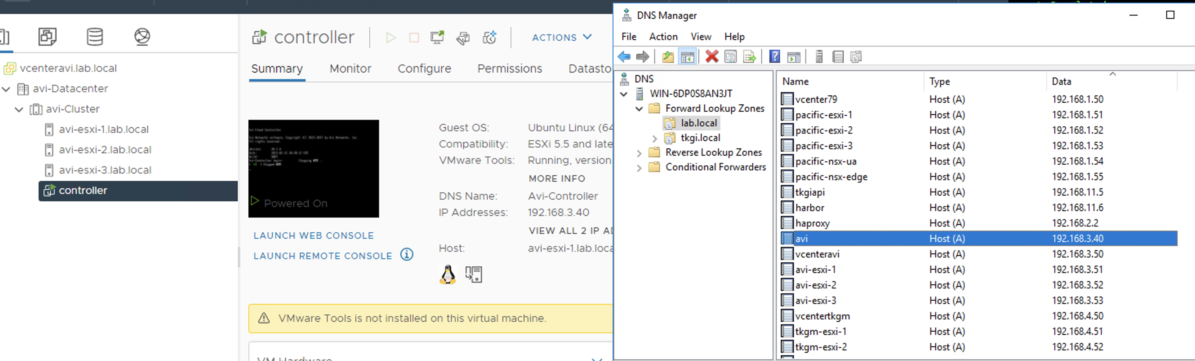
AVI 192.168.3.40 in DNS forward and reverse

Slide 10
AVI via Browser for final setup
Open browser to http://192.168.3.40
It may take a little bit before the GUI is up!

Slide 11
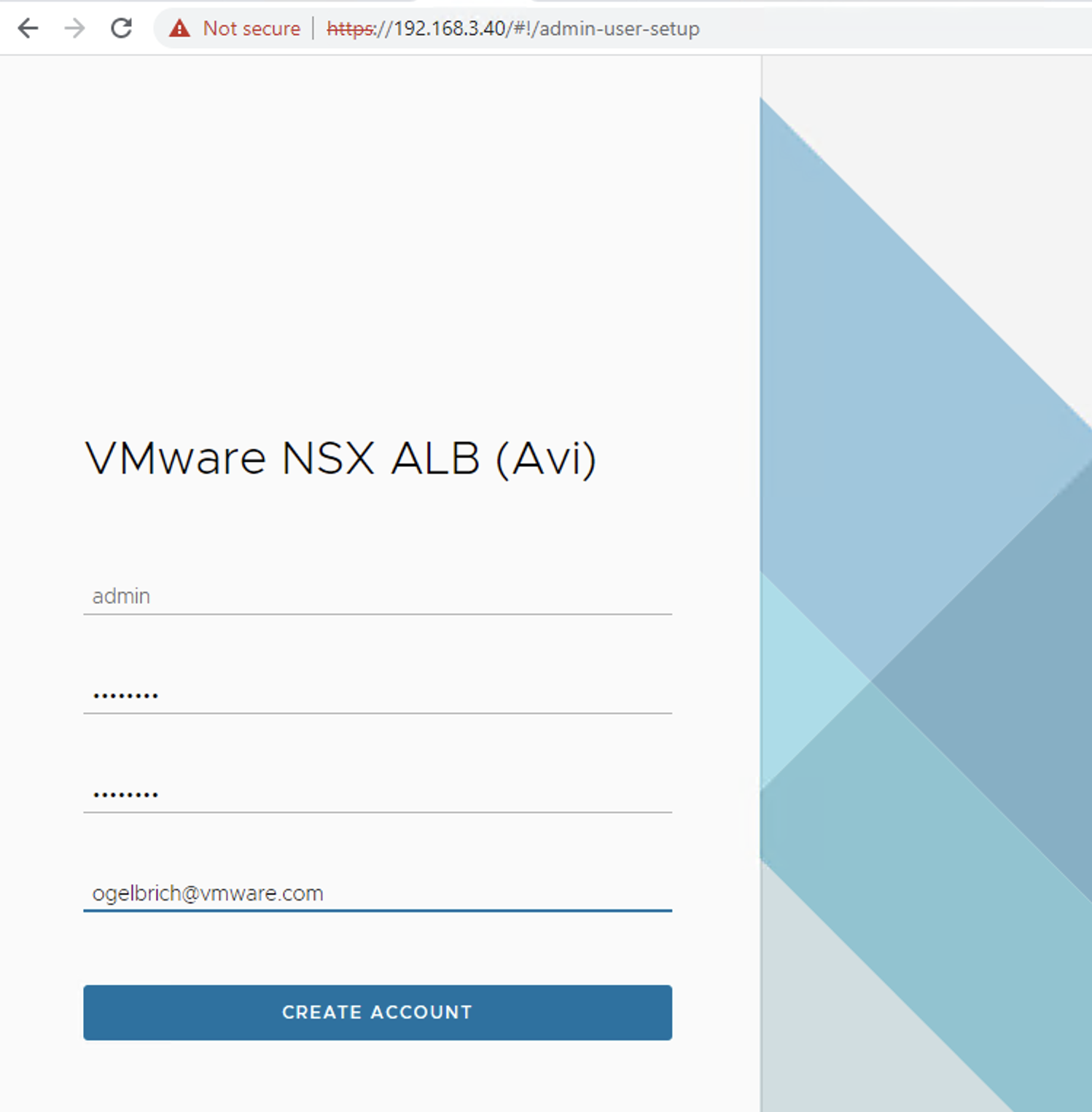
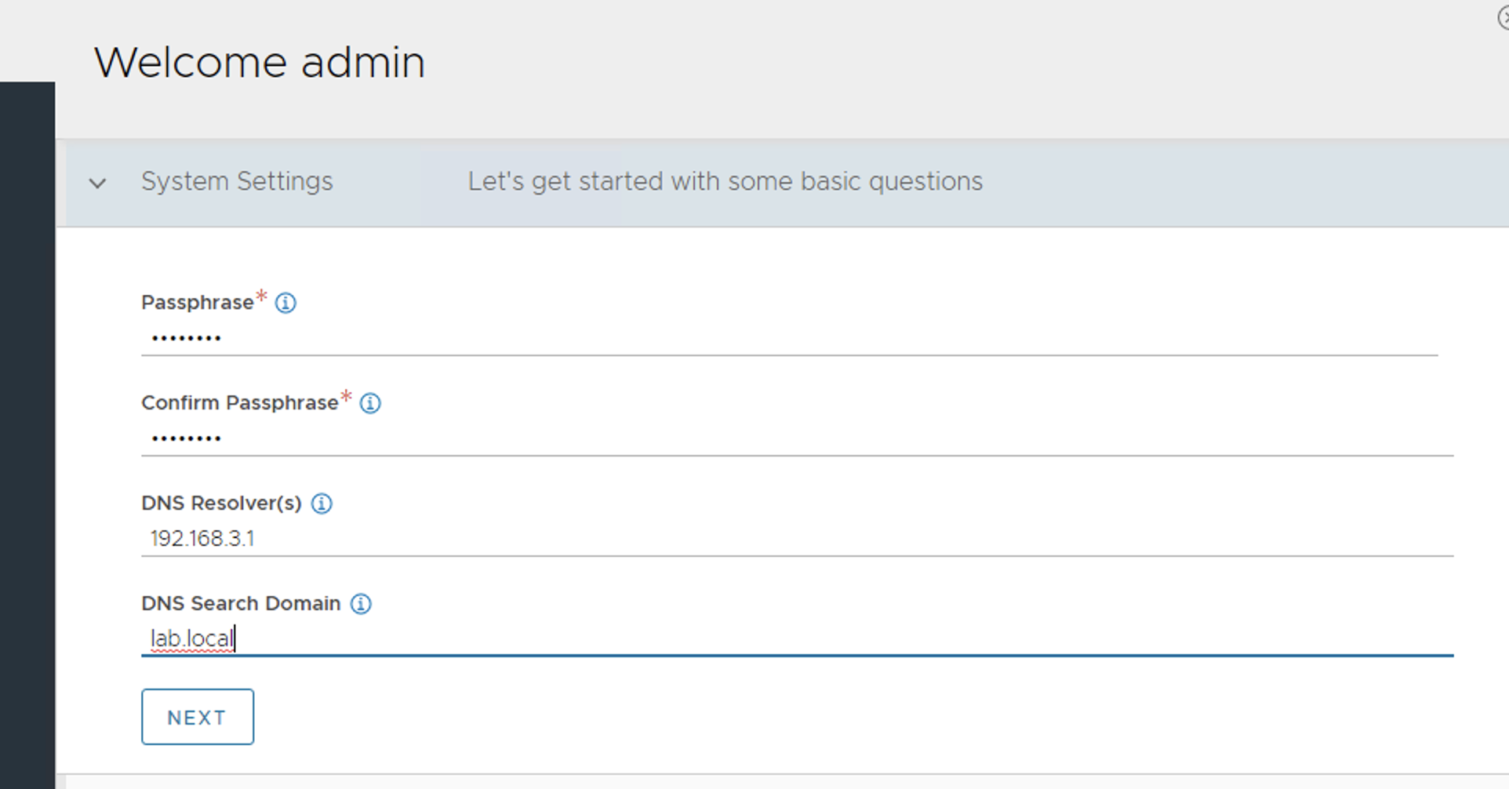
First time set up

Slide 12
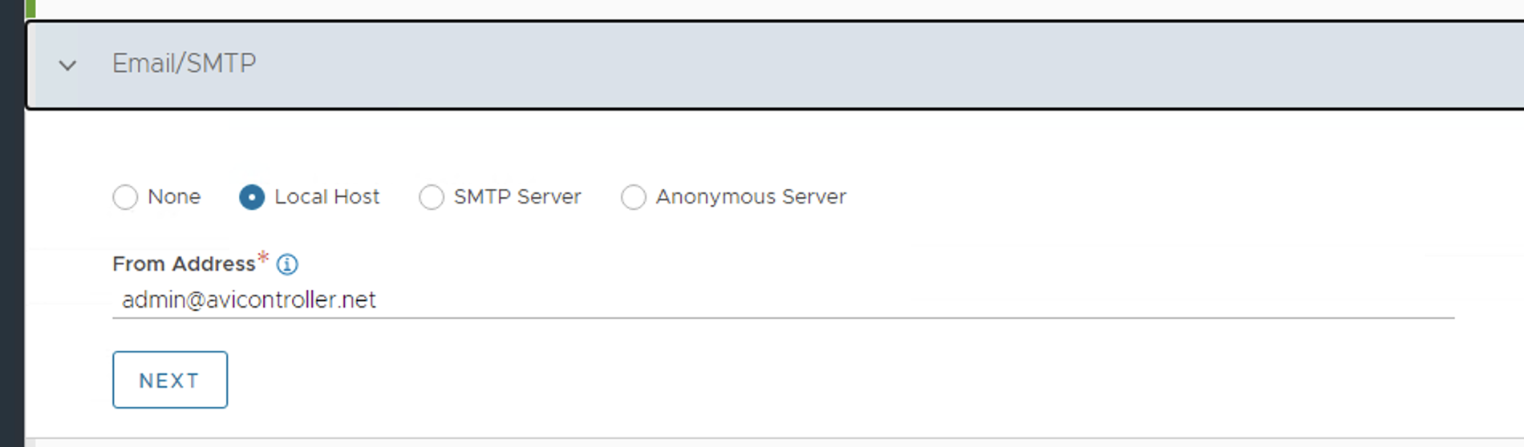
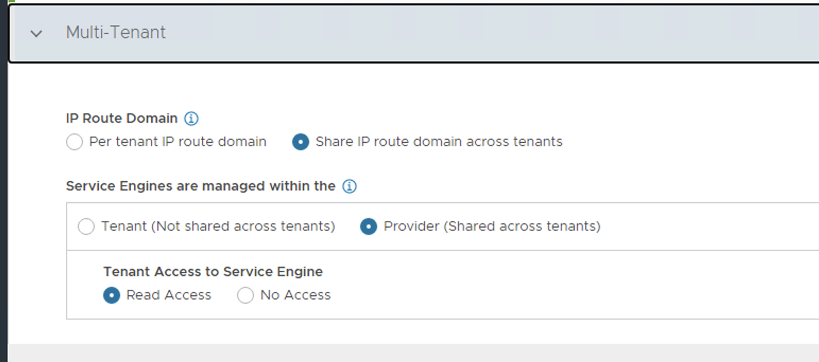
Frist time set up

Slide 13
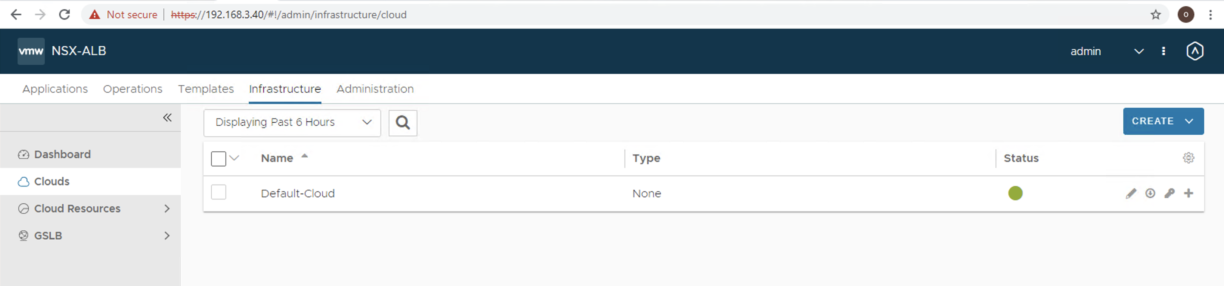
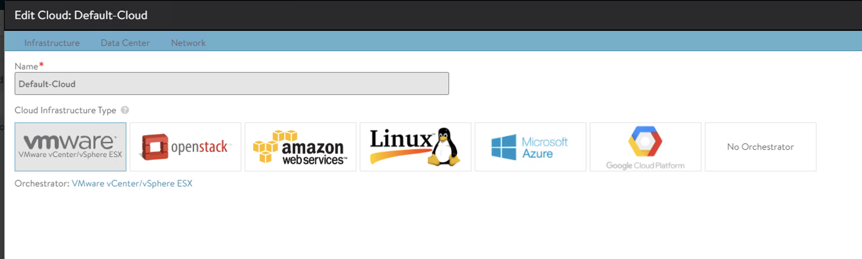
Create Default Cloud

Slide 14
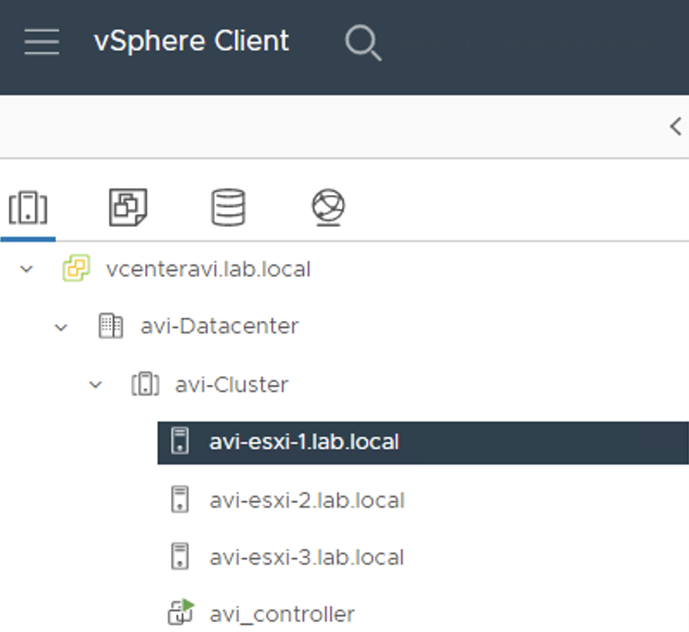
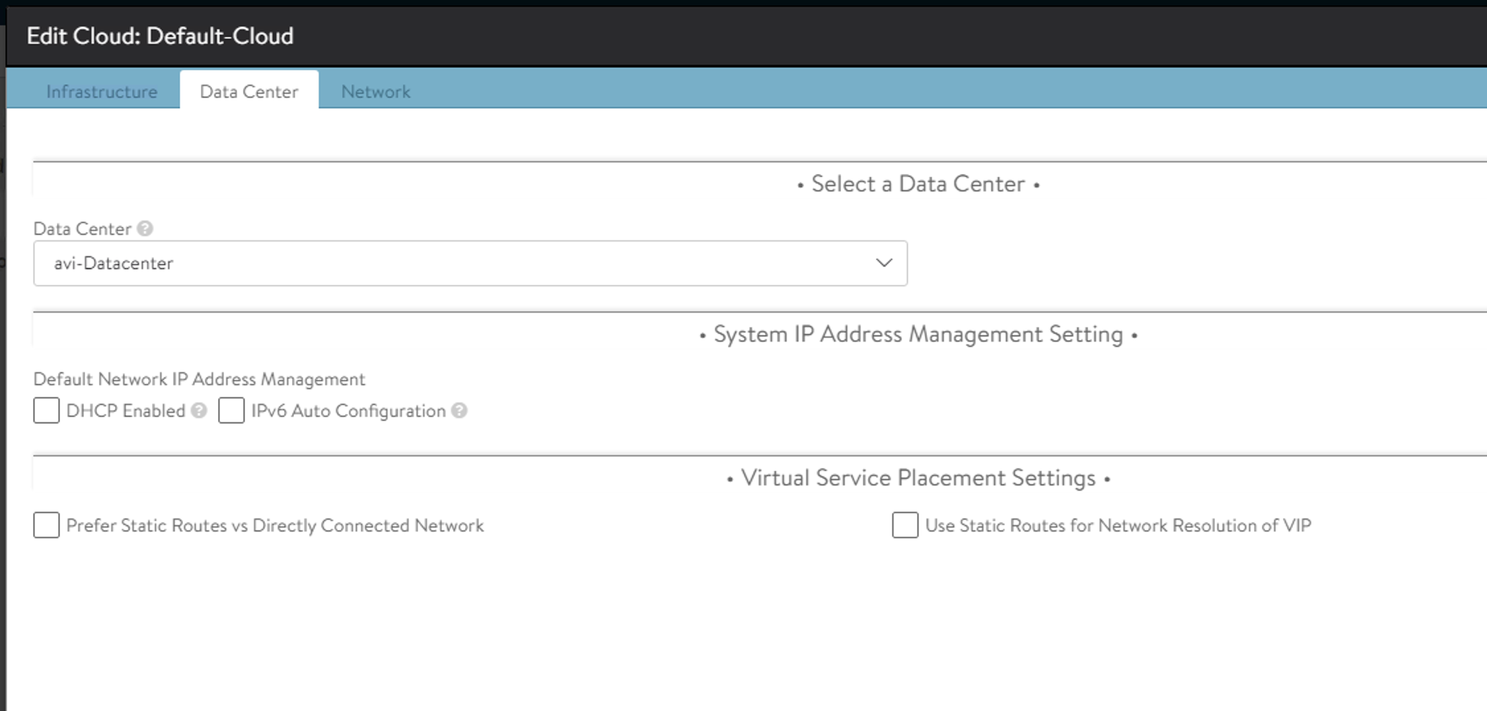
Default Cloud Data Center

Slide 15
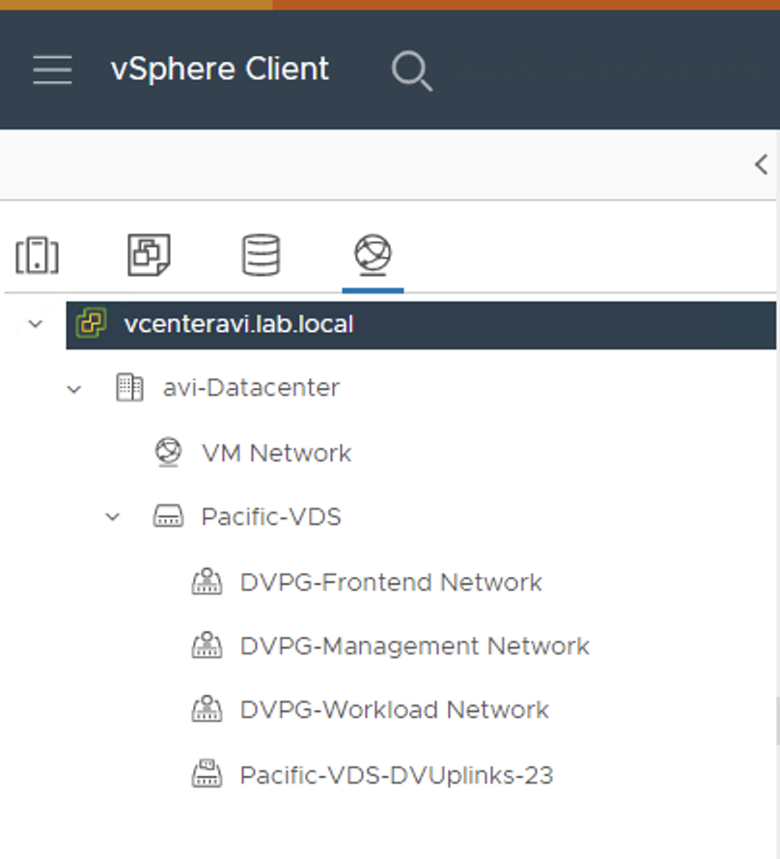
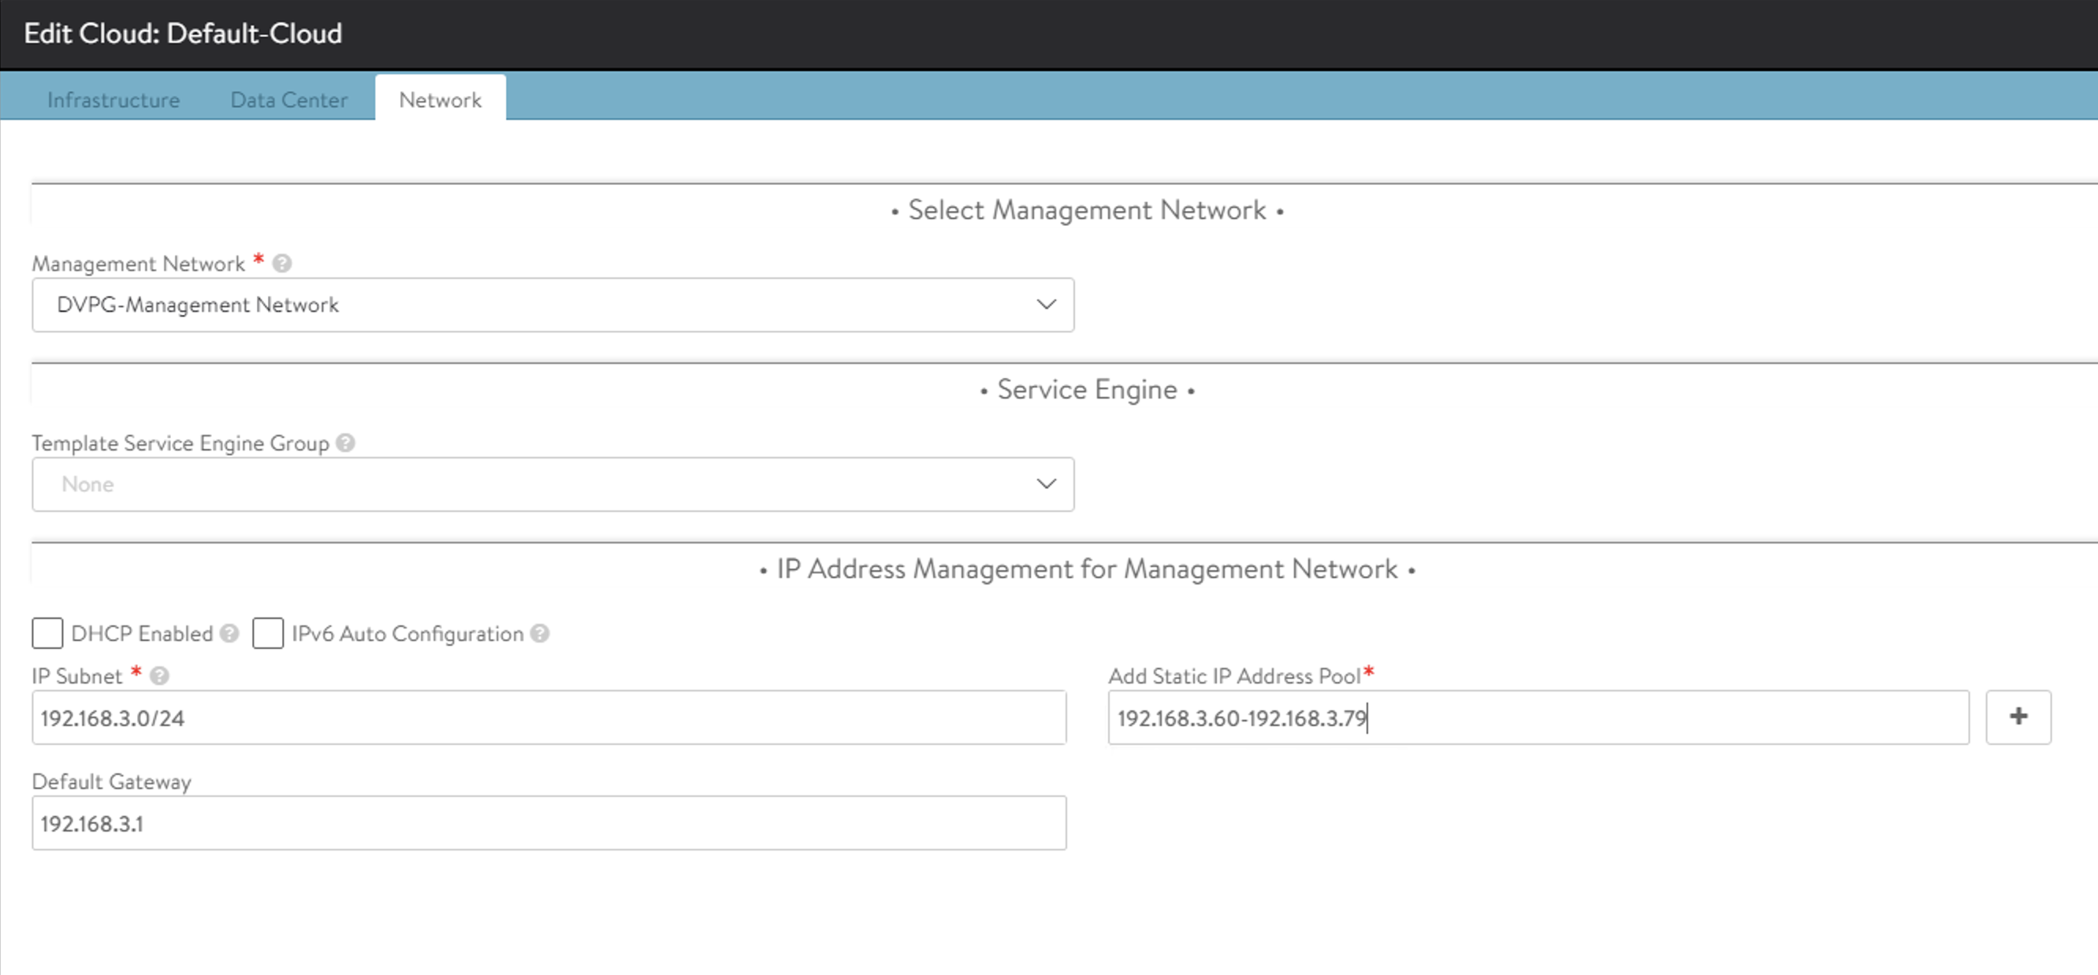
Default Cloud Networking

Slide 16

Default Cloud is green

Slide 17
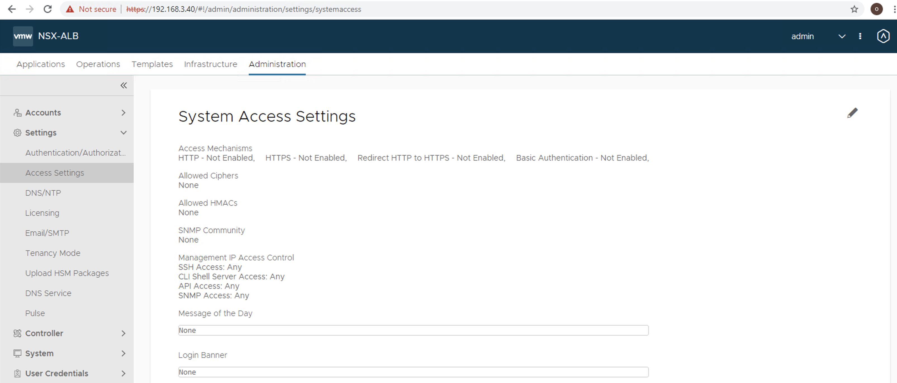
Edit Cert (Pencil)

Slide 18
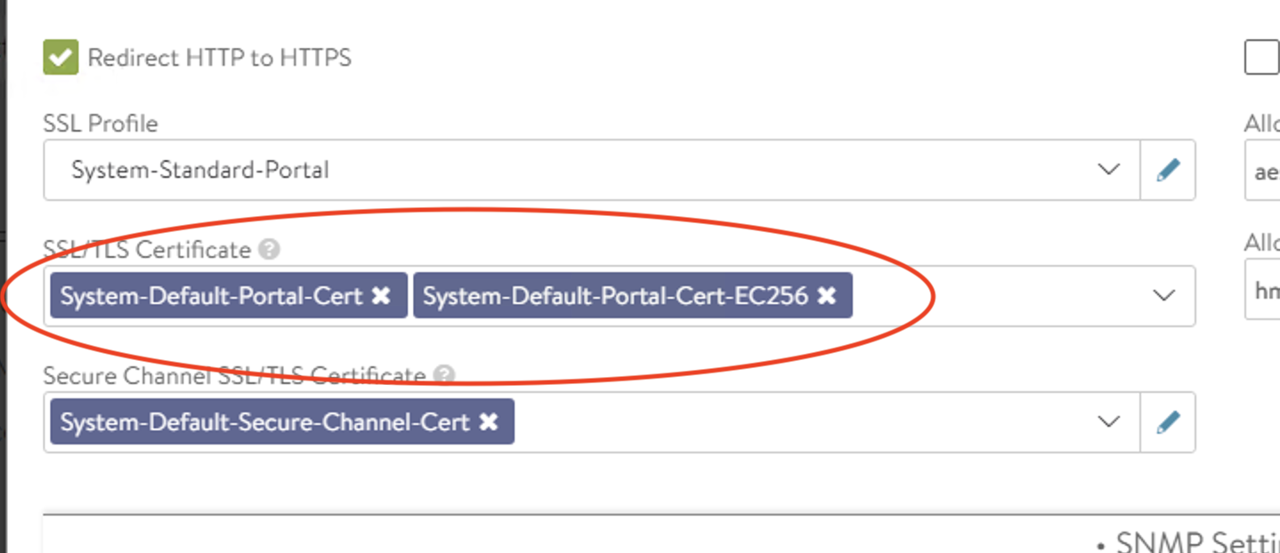
Delete these two certs

Slide 19
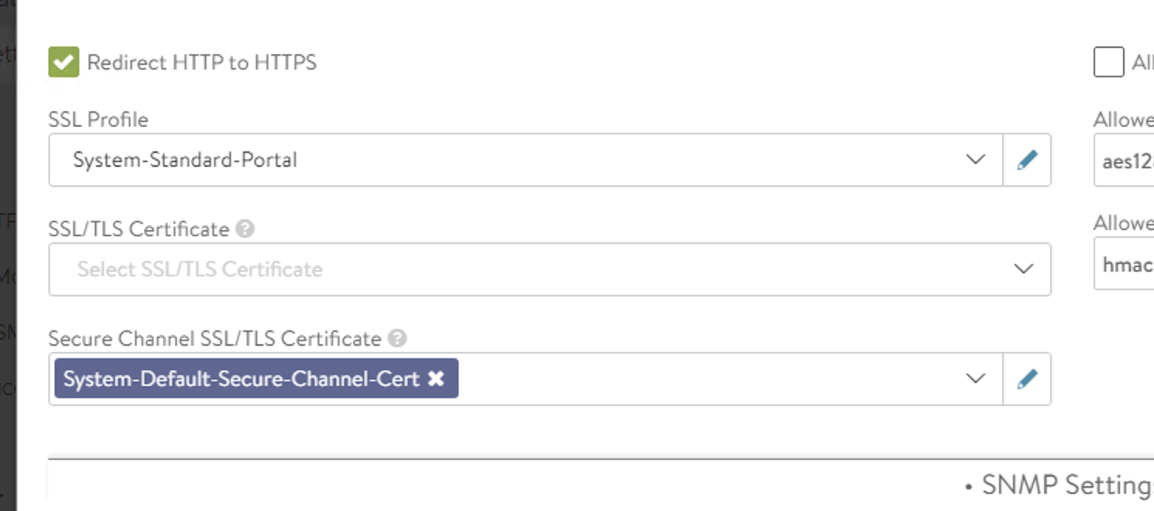
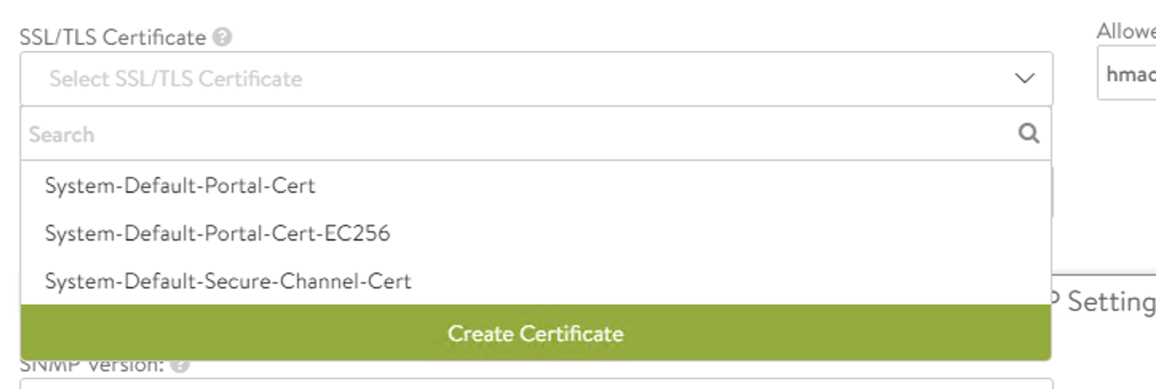
Create new Cert

Slide 20
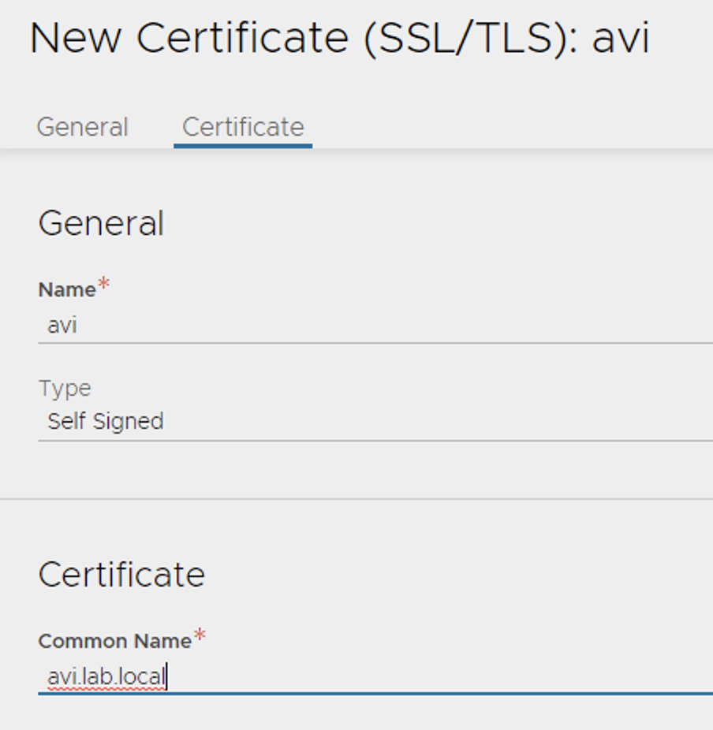
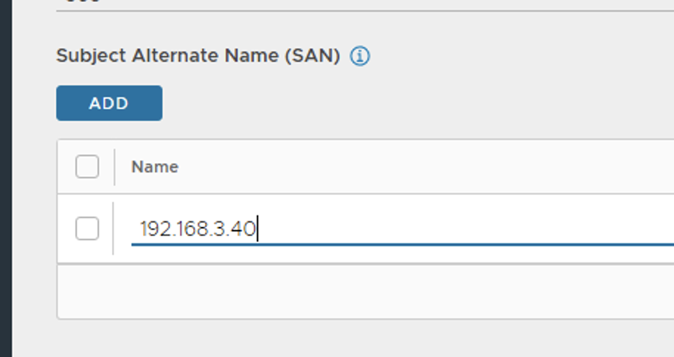
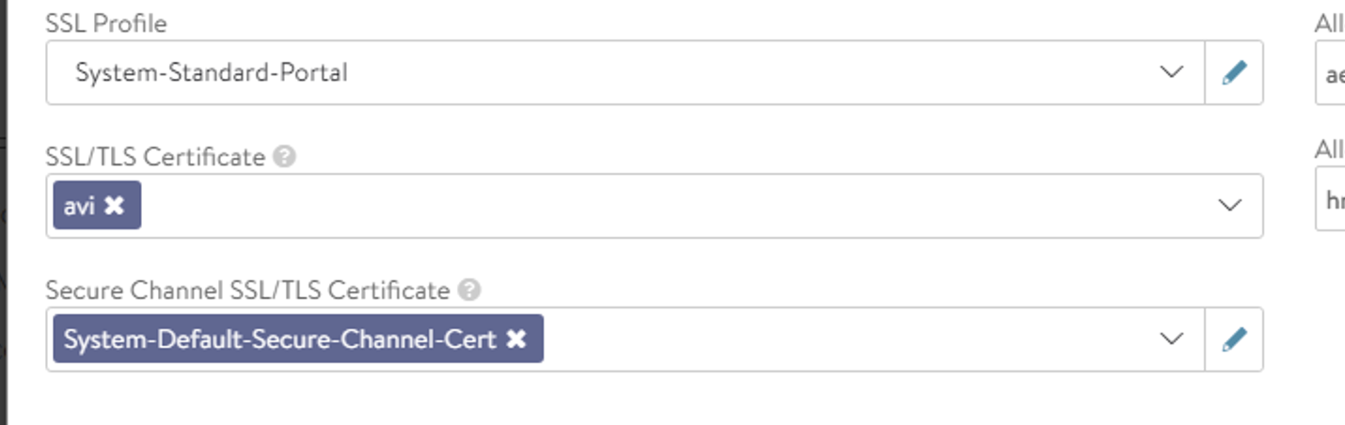
New cert with SAN

Slide 21
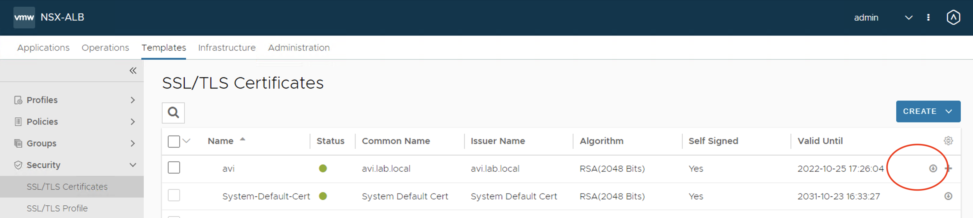
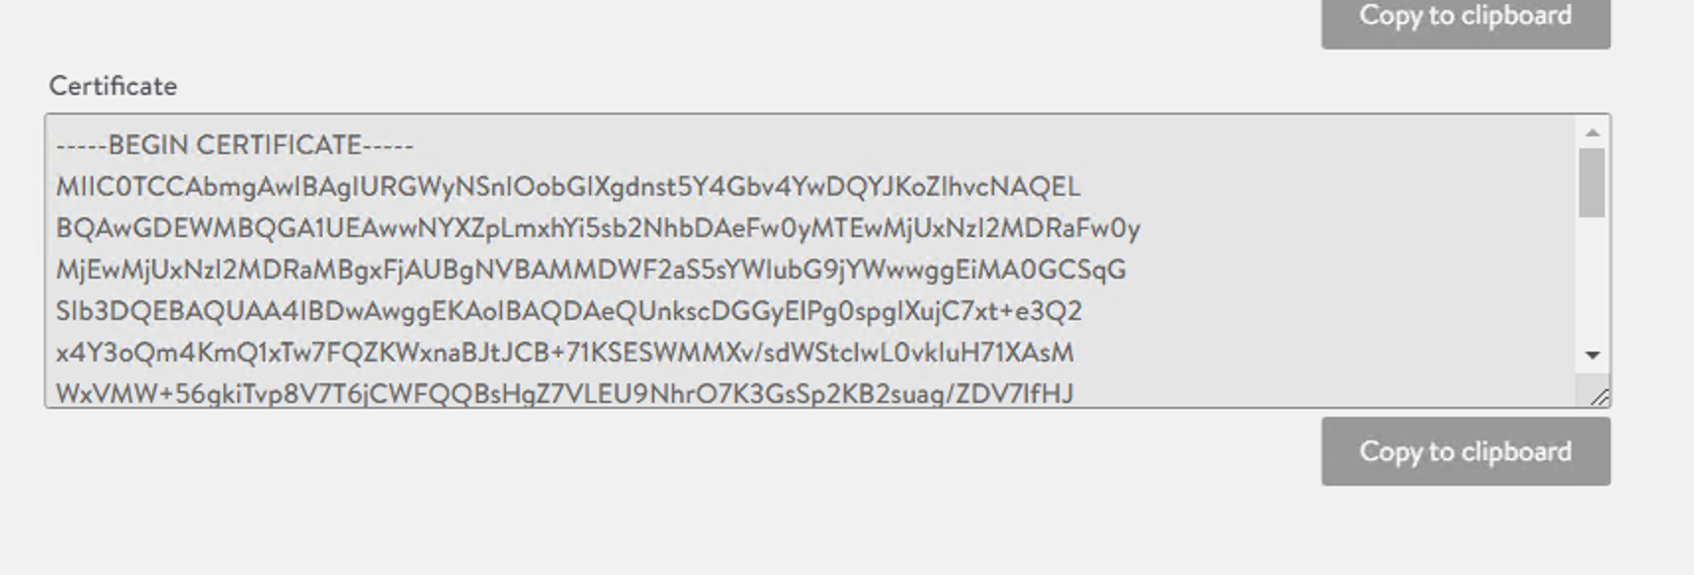
Save of the cert for vCenter WCP enablement

Slide 22
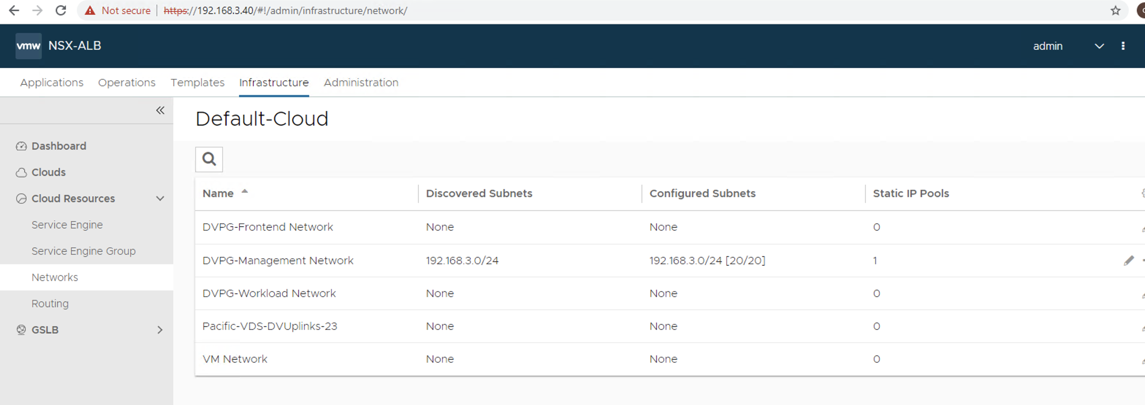
Front end network (edit)

Slide 23
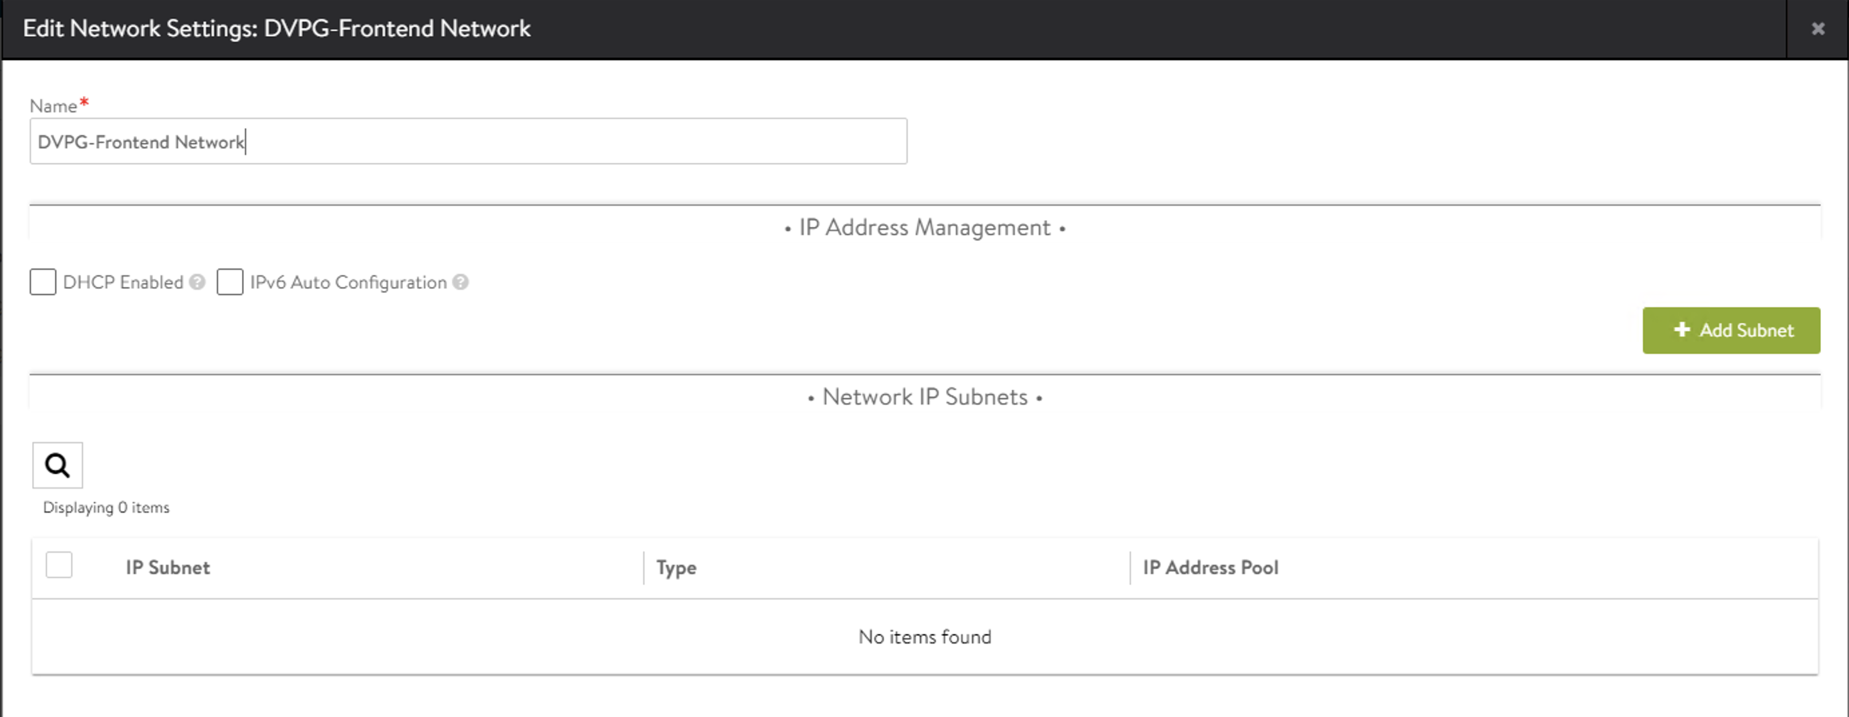
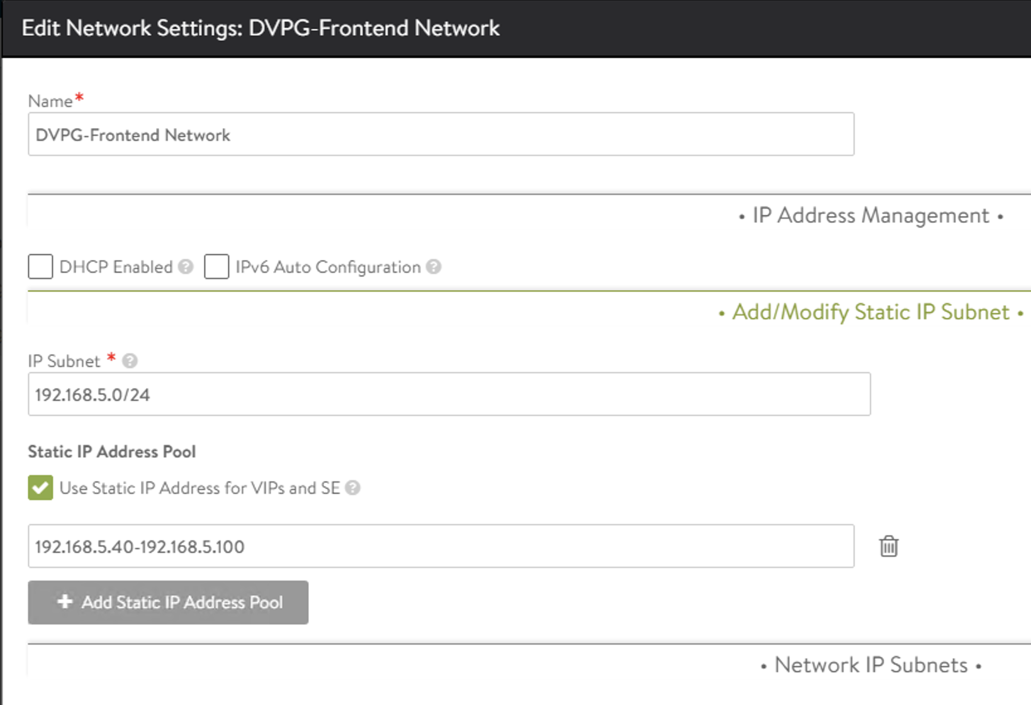
Front end network add subnet

Slide 24
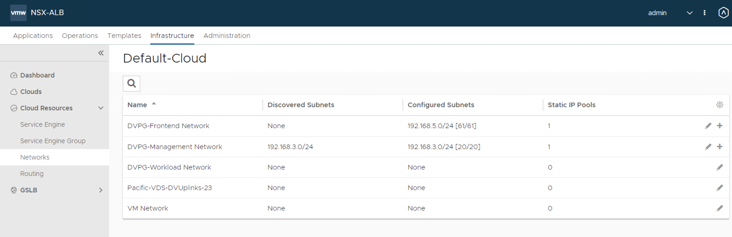
Result

Slide 25
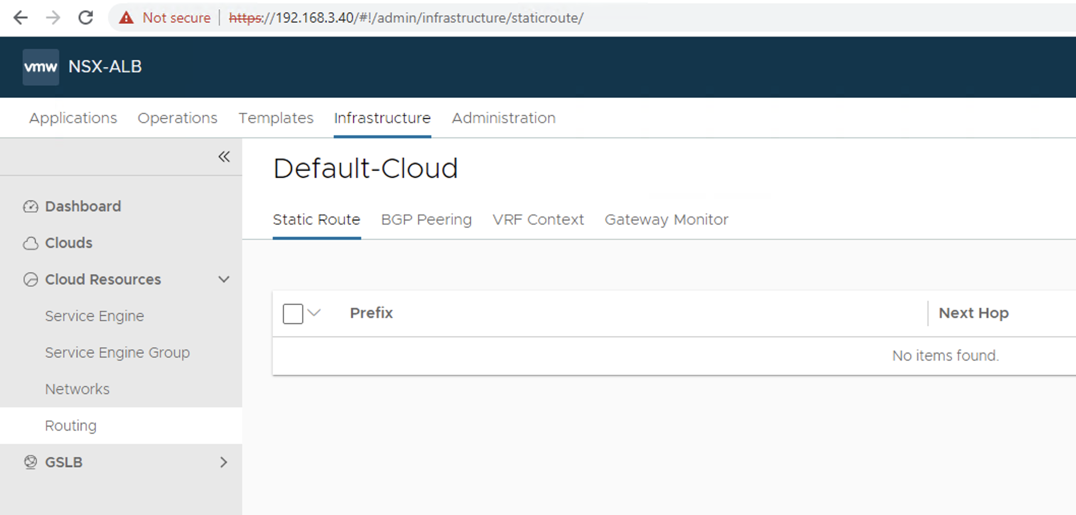
Routing

Slide 26
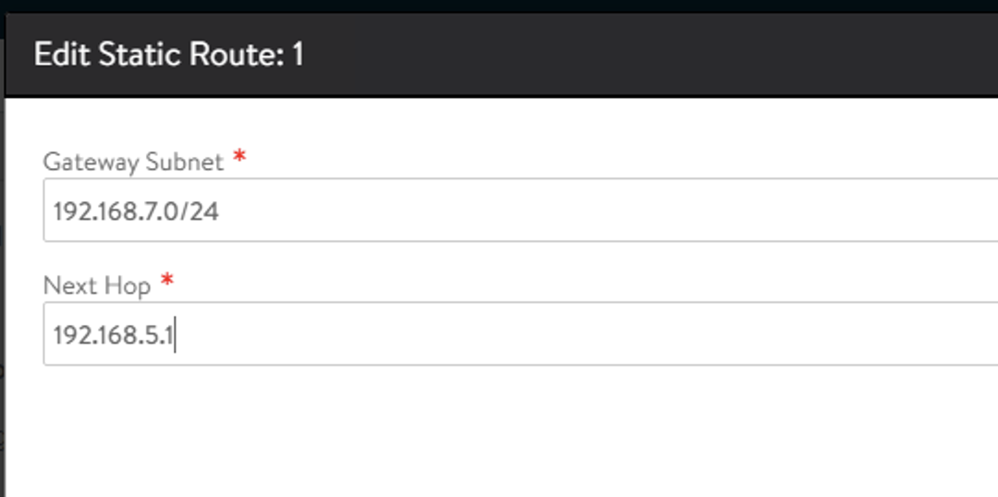
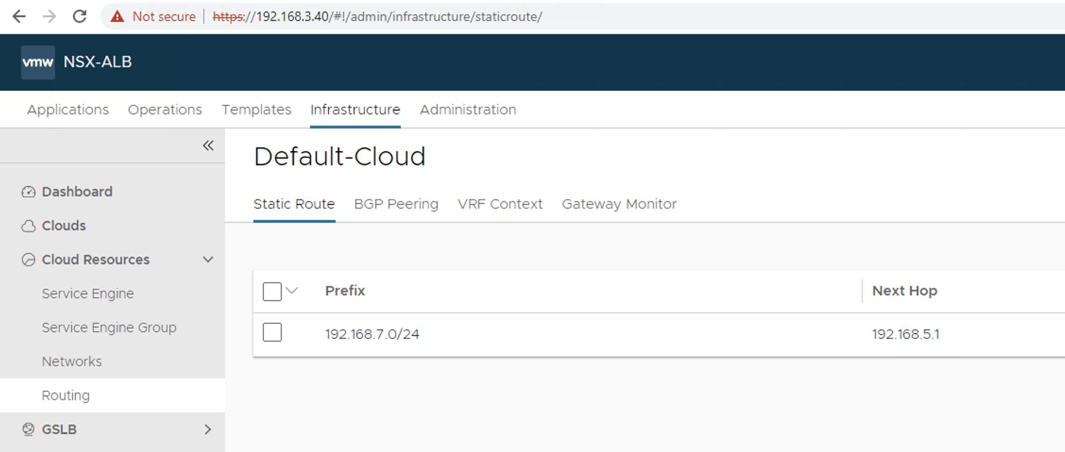
Routing

Slide 27
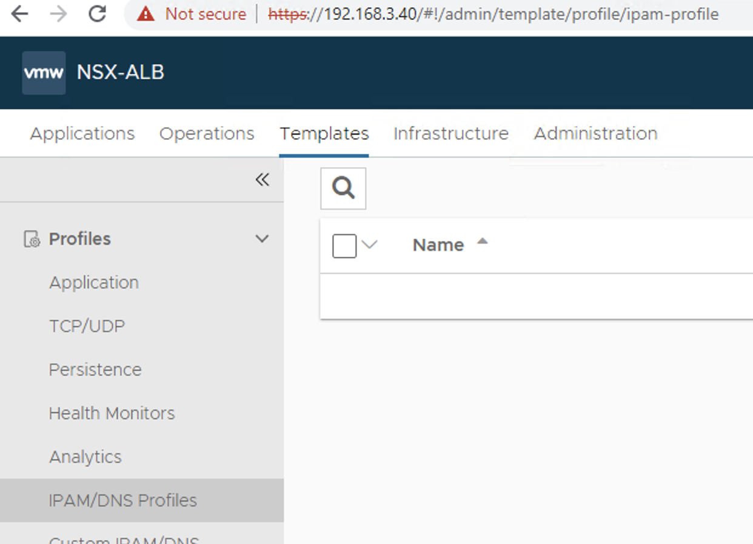
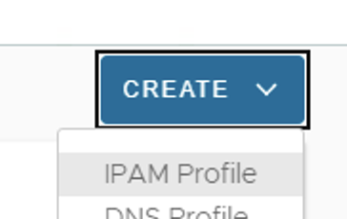
IPAM

Slide 28
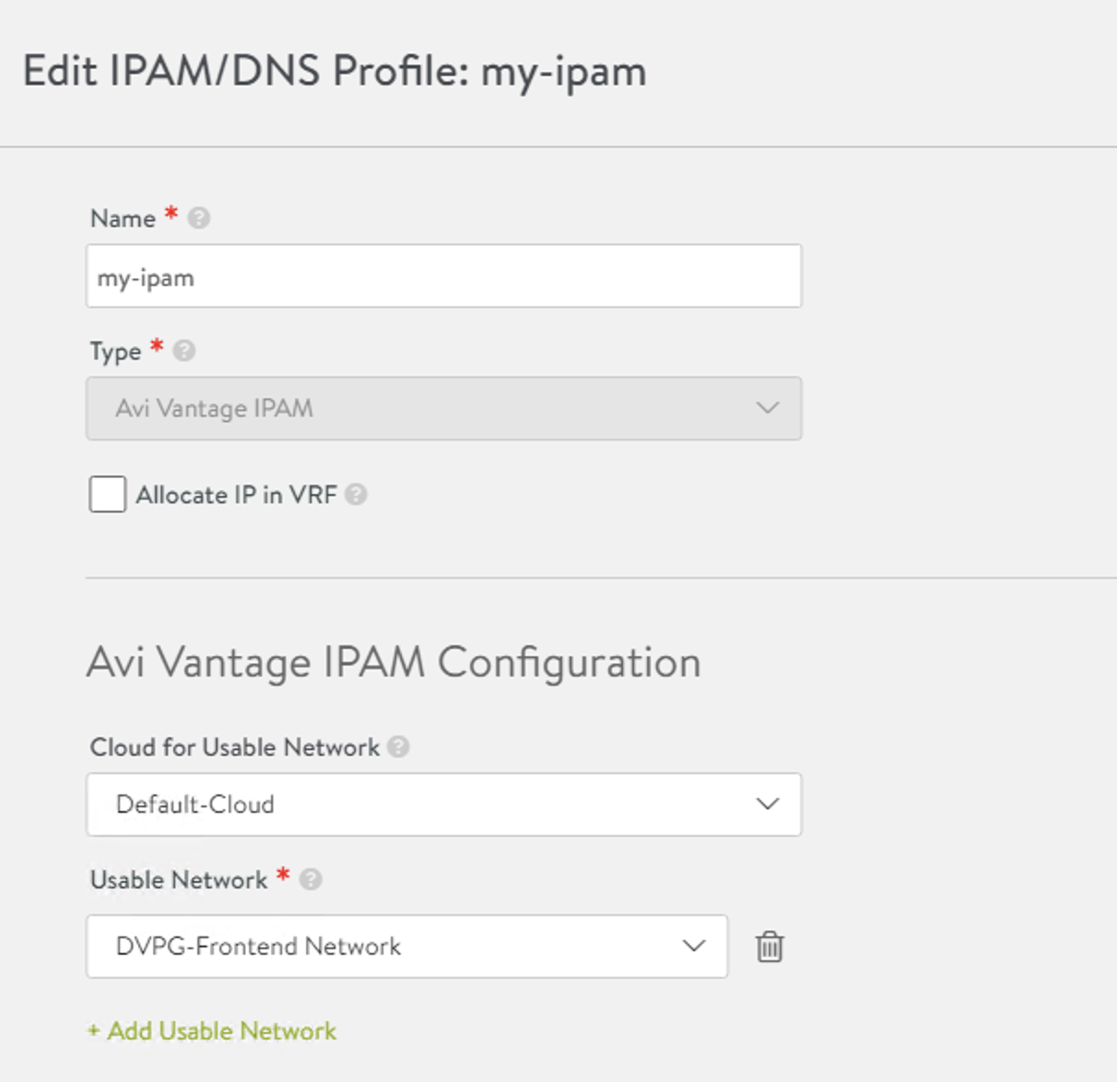
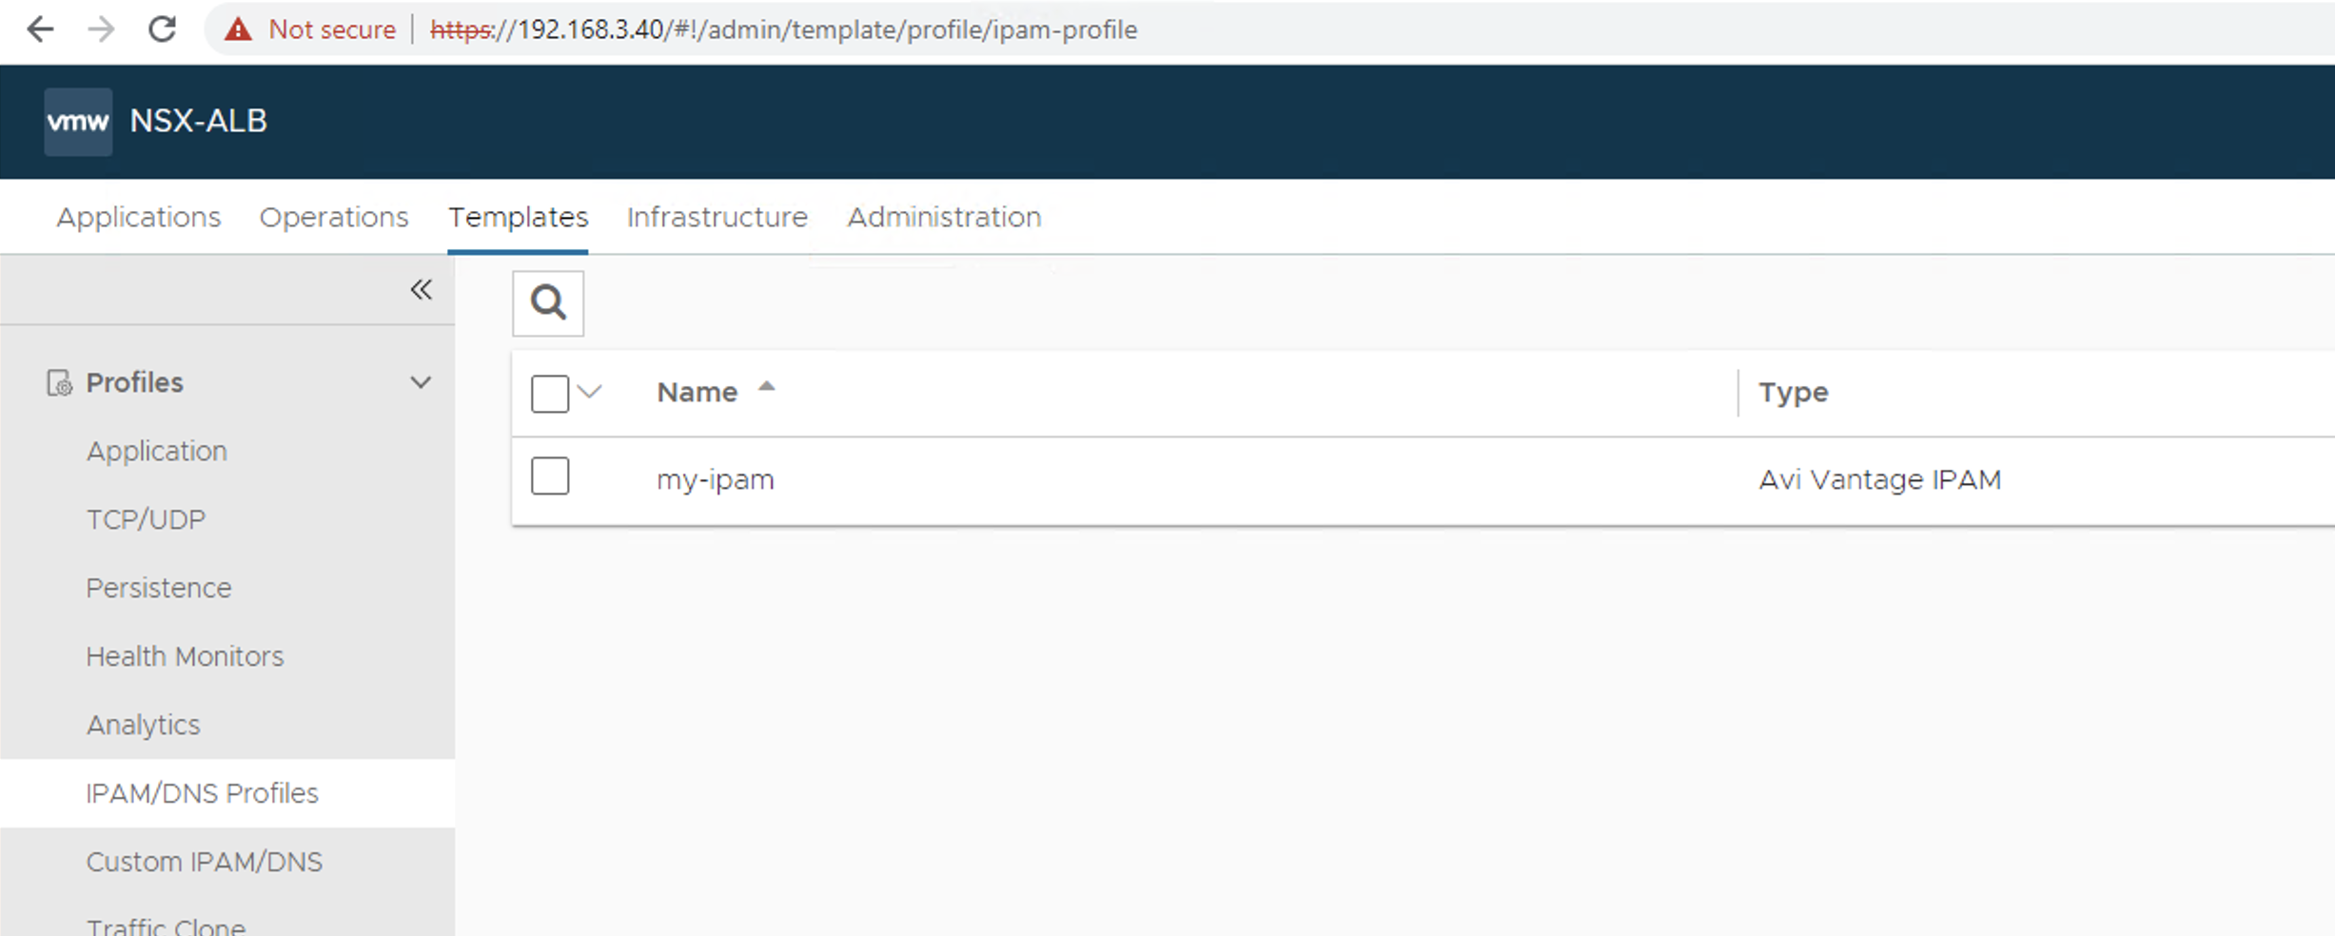
IPAM

Slide 29

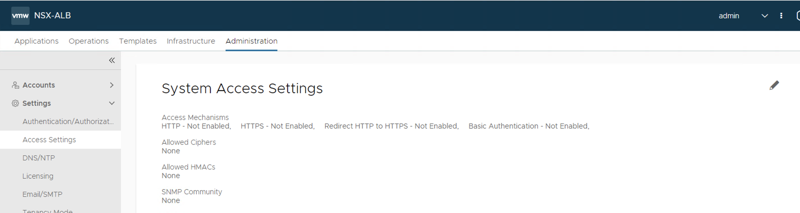
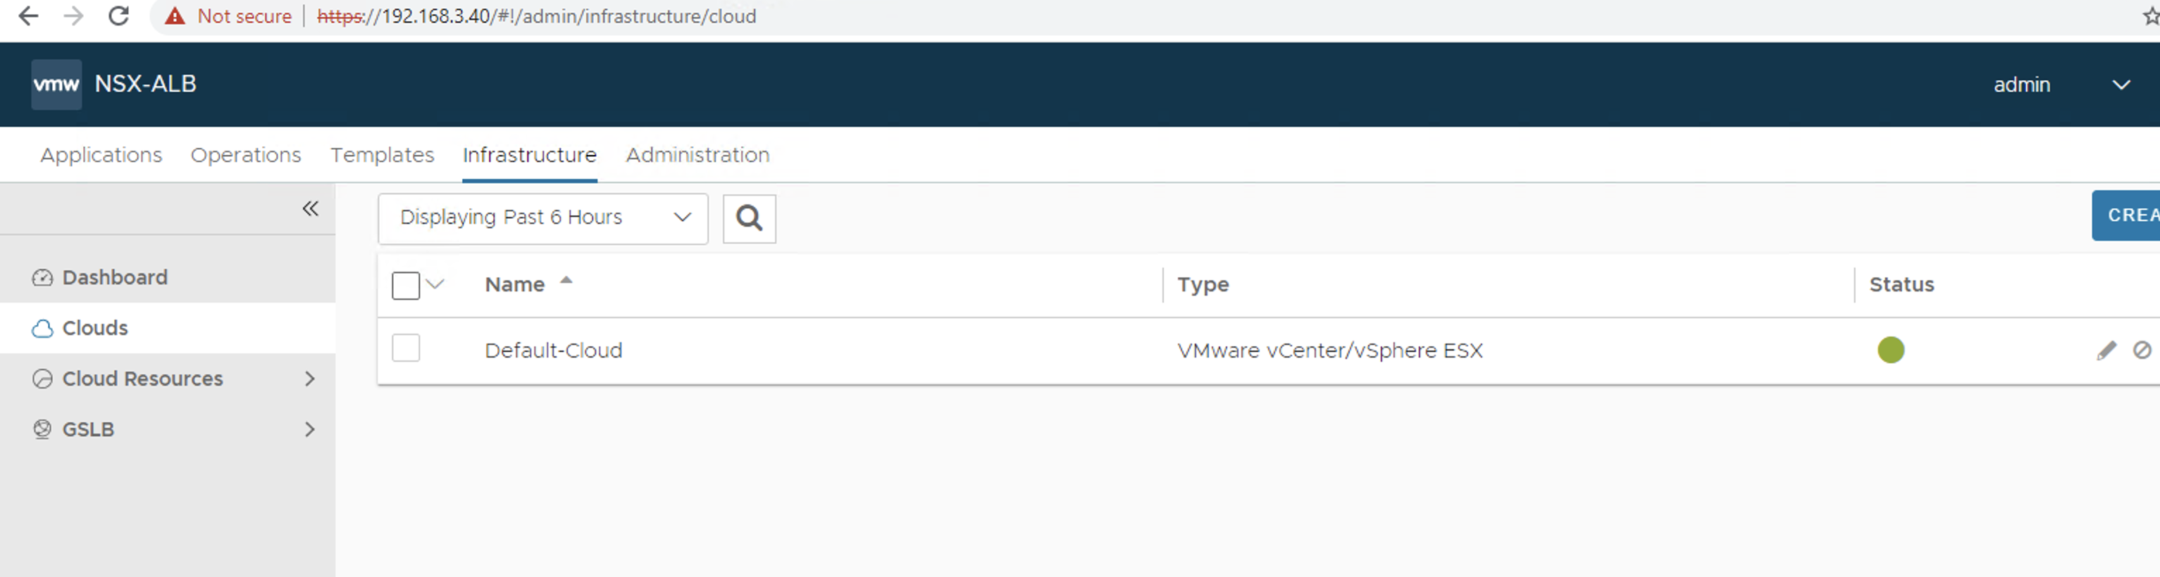
Default Cloud edit and add IPAM

Slide 30
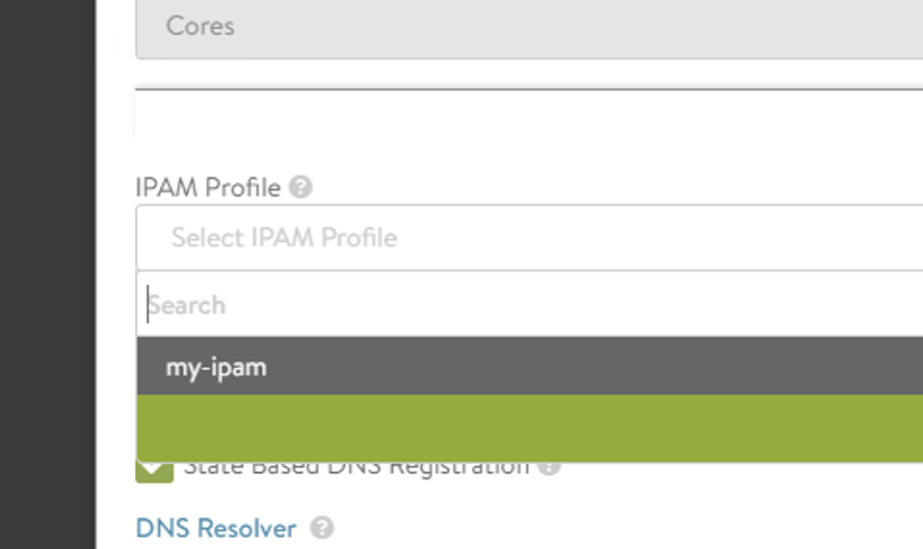
Default Cloud edit and add IPAM

Slide 31
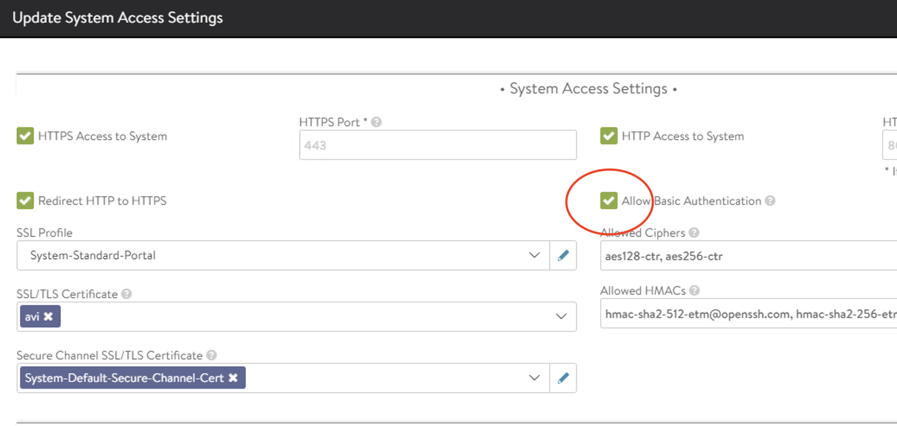
Due to a bug in u3 make sure basic auth is enabled

Slide 32
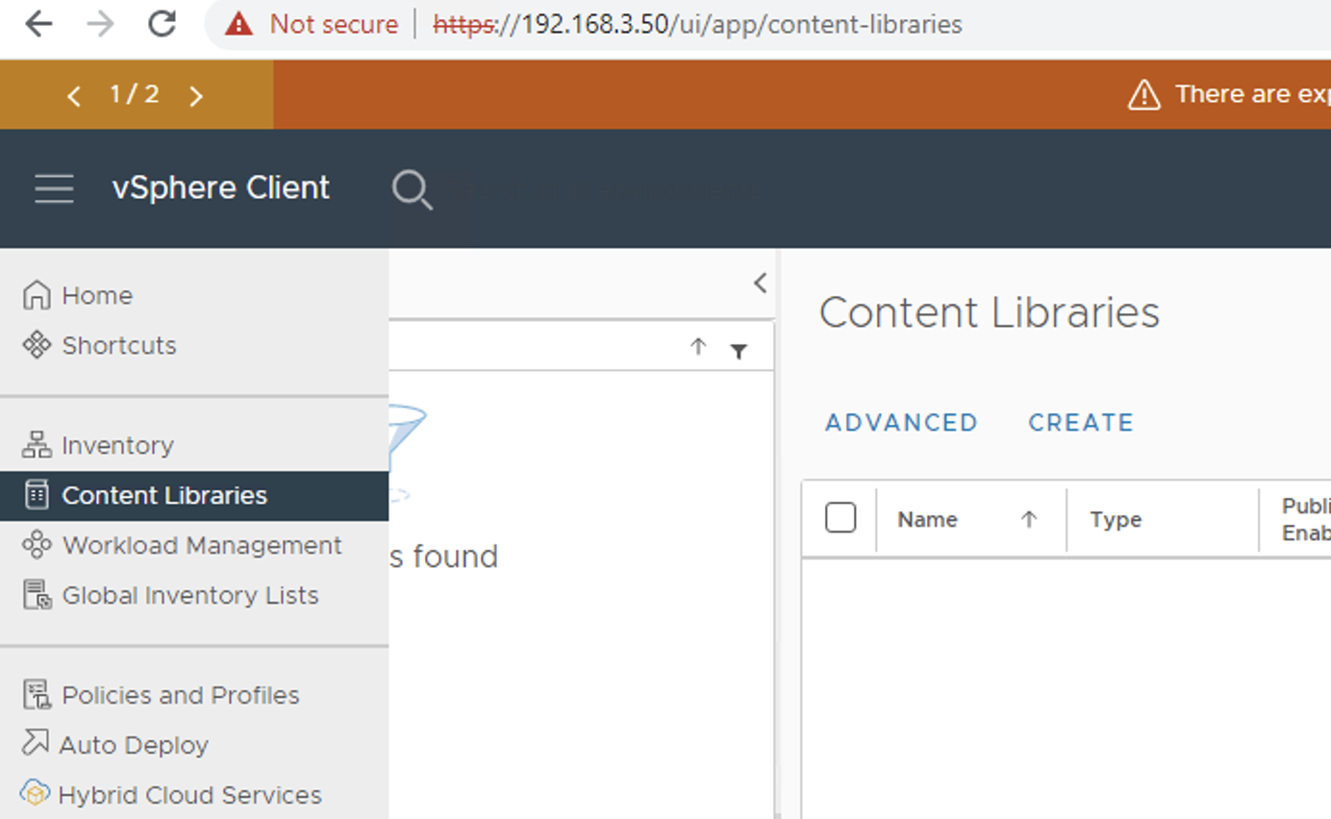
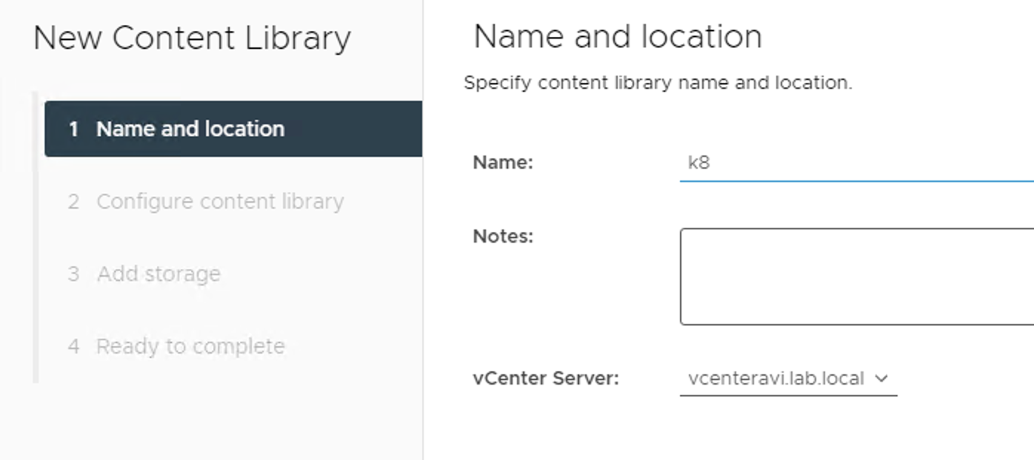
WCP enablement add content Lib

Slide 33
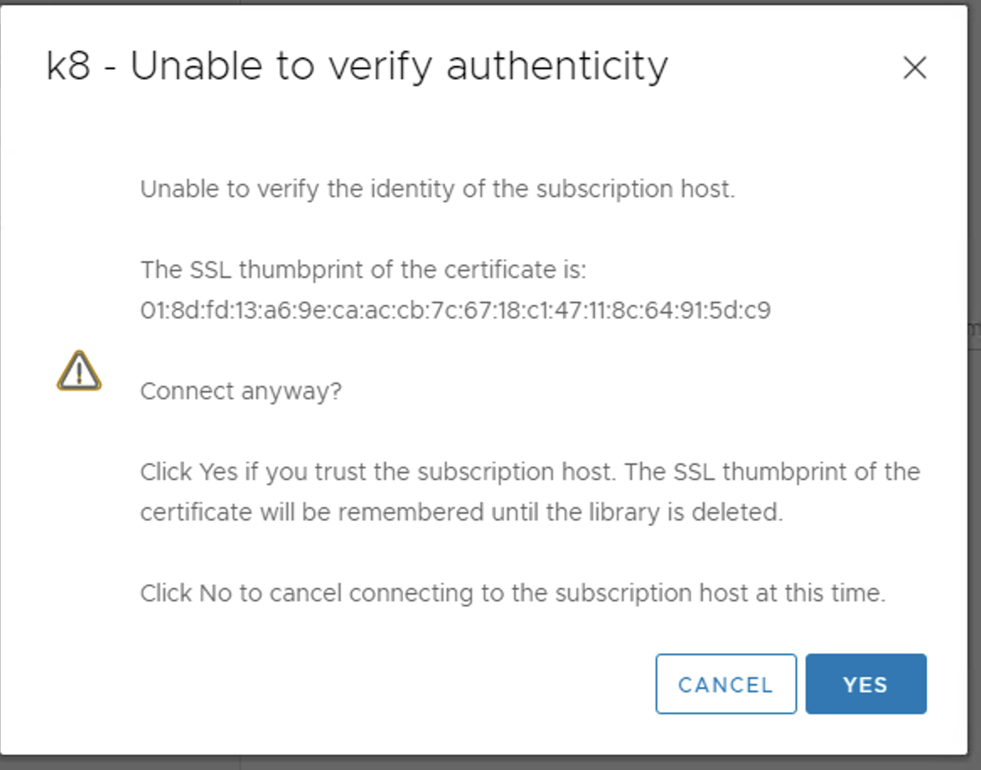
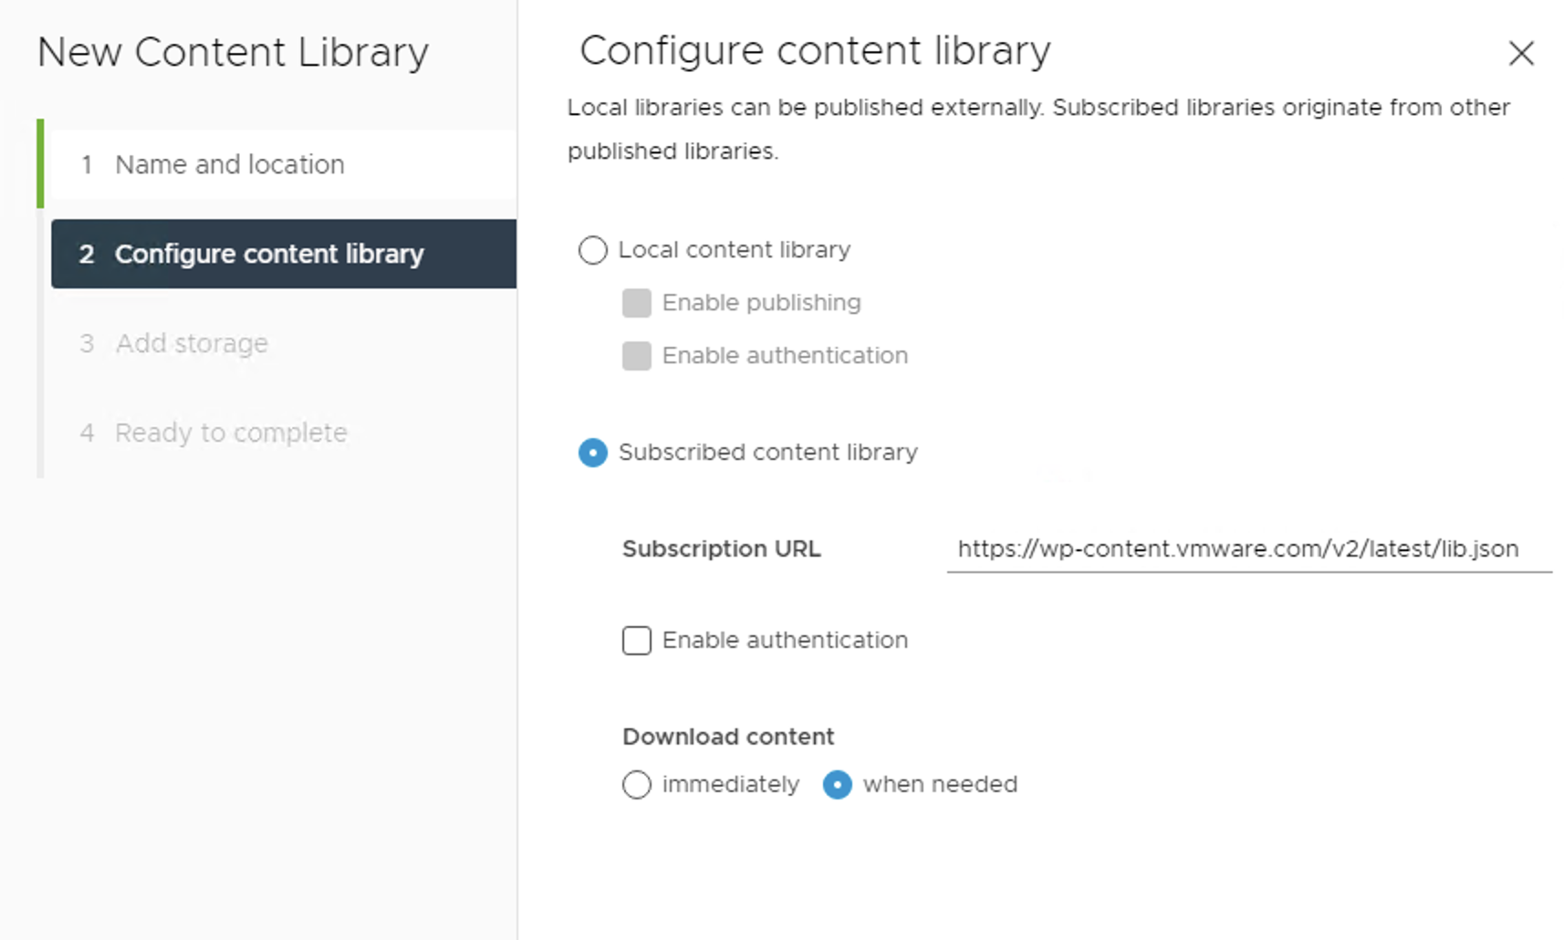
Content lib subscription

Slide 34
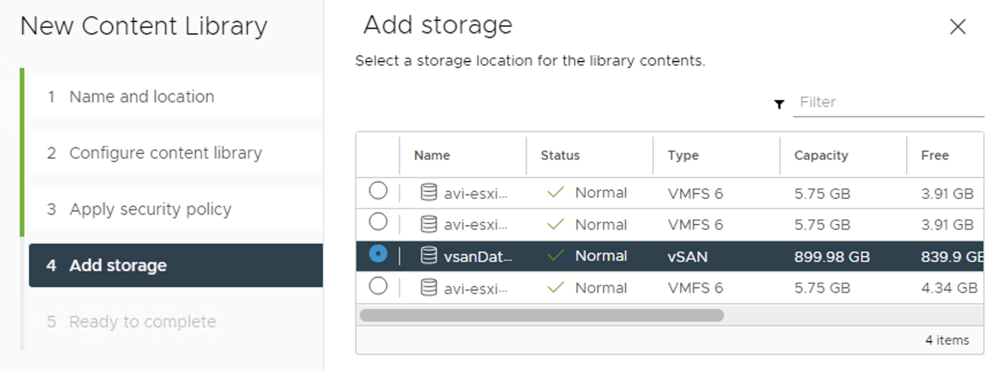
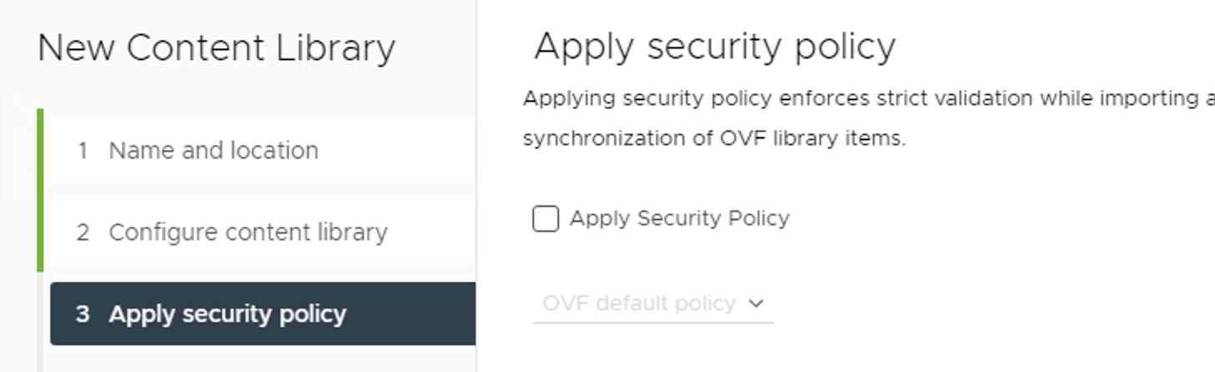
Content lib cont…

Slide 35
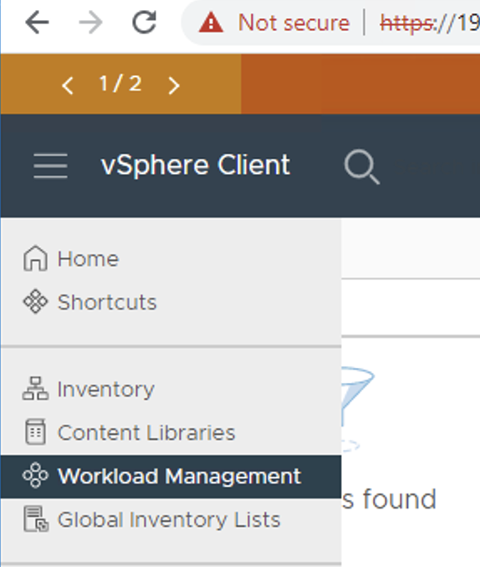
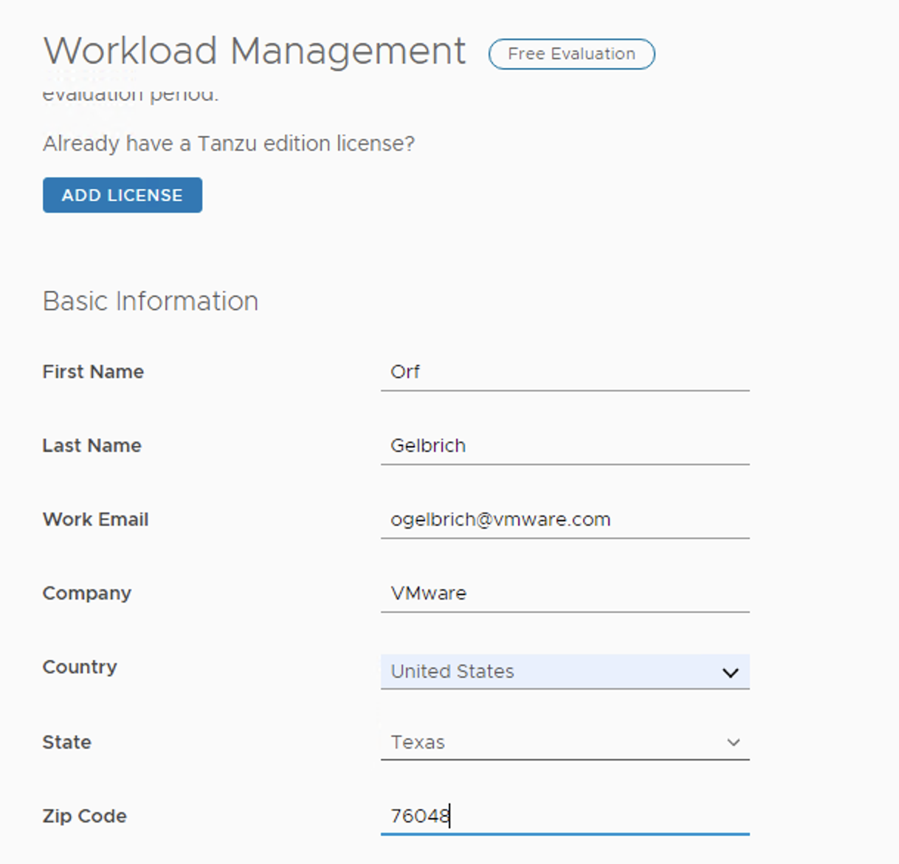
WCP enablement

Slide 36
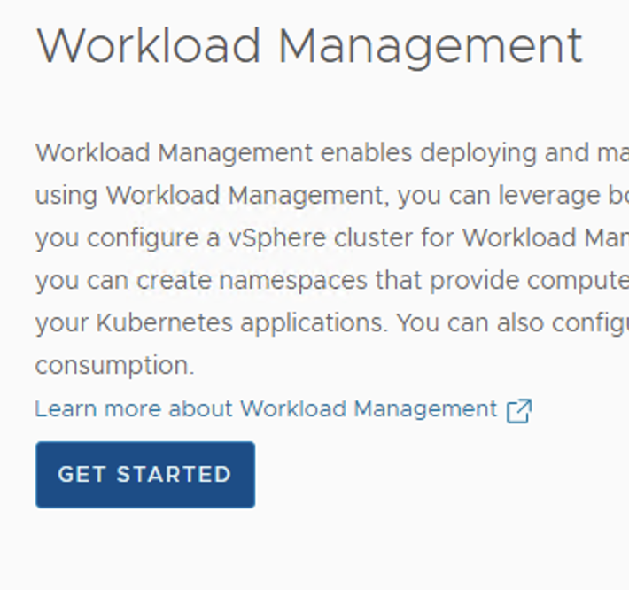

WCP Enablement cont…

Slide 37


WCP Enablement cont…

Slide 38

WCP Enablement cont…

Slide 39

WCP Enablement cont…

Slide 40

WCP Enablement cont…

Slide 41


WCP Enablement cont…

Slide 42

WCP Enablement cont…

Slide 43


WCP Enablement cont…

Slide 44

WCP Enablement cont…

Slide 45

WCP Enablement cont…

Slide 46

Did I fat finger the AVI password? Edit here:

Slide 47

Did I fat finger the AVI password?

Slide 48
Still an issue… ssh to vCenter…
ssh to vCenter ssh root@192.168.3.50
shell
/usr/lib/vmware-wcp/decryptK8Pwd.py
ssh to IP and use password from above command
kubectl get events -n vmware-system-ako -w
kubectl get pods -A | grep ako
kubectl logs -n vmware-system-ako pod/vmware-system-ako-ako-controller-manager-85bb7dd4-wnhrg
kubectl get secrets -A | grep -i ako
kubectl describe secrets/avi-secret -n vmware-system-ako
kubectl get secret avi-secret -n vmware-system-ako -n vmware-system-ako -o jsonpath='{.data}'
echo "Vk13YXJlMSE=" | base64 --decode

Slide 49

Well look what we have here user ID with a training space…

Slide 50
The system should update this user field but I have no time…
echo -n '-----BEGIN CERTIFICATE-----
My cert here….OtDaScc=
-----END CERTIFICATE-----' > ./certificateAuthorityData.txt
echo -n 'VMware1!' > ./password.txt
echo -n 'admin' > ./username.txt
kubectl delete secret avi-secret -n vmware-system-ako
kubectl create secret generic avi-secret -n vmware-system-ako --from-file=./certificateAuthorityData.txt --from-file=./password.txt --from-file=./username.txt
kubectl edit secret avi-secret -n vmware-system-ako

Slide 51
Pod is running now…
root@4202c1b4753322614d82535f07f425bd [ ~ ]# kubectl get pods -A | grep -i ako
vmware-system-ako vmware-system-ako-ako-controller-manager-684cc57587-k4pvv 1/1 Running 28 139m
root@4202c1b4753322614d82535f07f425bd [ ~ ]#

Slide 52


SE are running now… and WCP green

Slide 53

Create namespace

Slide 54

Add permissions and storage

Slide 55


VM class and Content lib

Slide 56
Loging on
/usr/local/bin/kubectl-vsphere login --vsphere-username administrator@vsphere.local --server=https://192.168.5.40 --insecure-skip-tls-verify
kubectl config use-context namespace1000
[root@orfdns ~]# k get nodes
NAME STATUS ROLES AGE VERSION
42025674cc72a310700121faddd8890a Ready control-plane,master 158m v1.21.0+vmware.1-wcp
4202aa30779d4936ec9a64301df0434b Ready control-plane,master 158m v1.21.0+vmware.1-wcp
4202c1b4753322614d82535f07f425bd Ready control-plane,master 164m v1.21.0+vmware.1-wcp

Slide 57
Create Guest cluster
kubectl-vsphere login --vsphere-username administrator@vsphere.local --server=https://192.168.5.40 --insecure-skip-tls-verify
kubectl config use-context namespace1000
k apply -f ./7u3cluster_photon.yaml
kubectl vsphere login --server 192.168.5.40 --vsphere-username administrator@vsphere.local --tanzu-kubernetes-cluster-namespace namespace1000 --tanzu-kubernetes-cluster-name workload-vsphere-tkg2 --insecure-skip-tls-verify
k config use-context workload-vsphere-tkg2
kubectl apply -f https://github.com/ogelbric/YAML/raw/master/authorize-psp-for-gc-service-accounts.yaml
k apply -f /root/7u2a/google-nginx2.yaml

Slide 58
Overall Help
https://github.com/ogelbric/YAML/blob/master/DemoScript.txt

